Slide 1
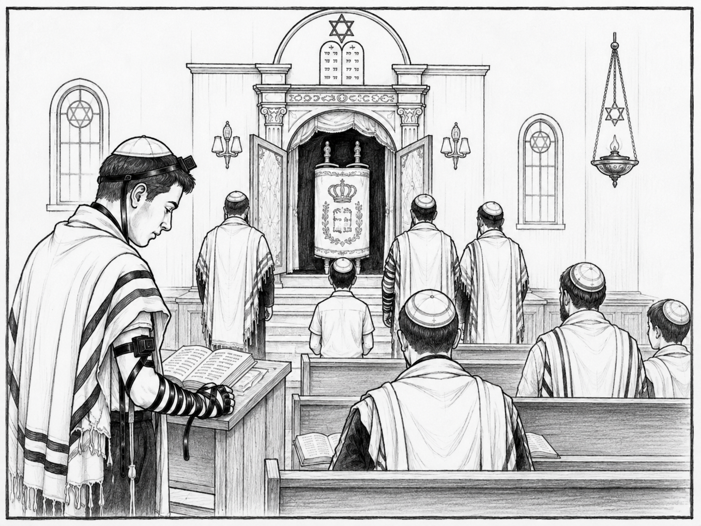
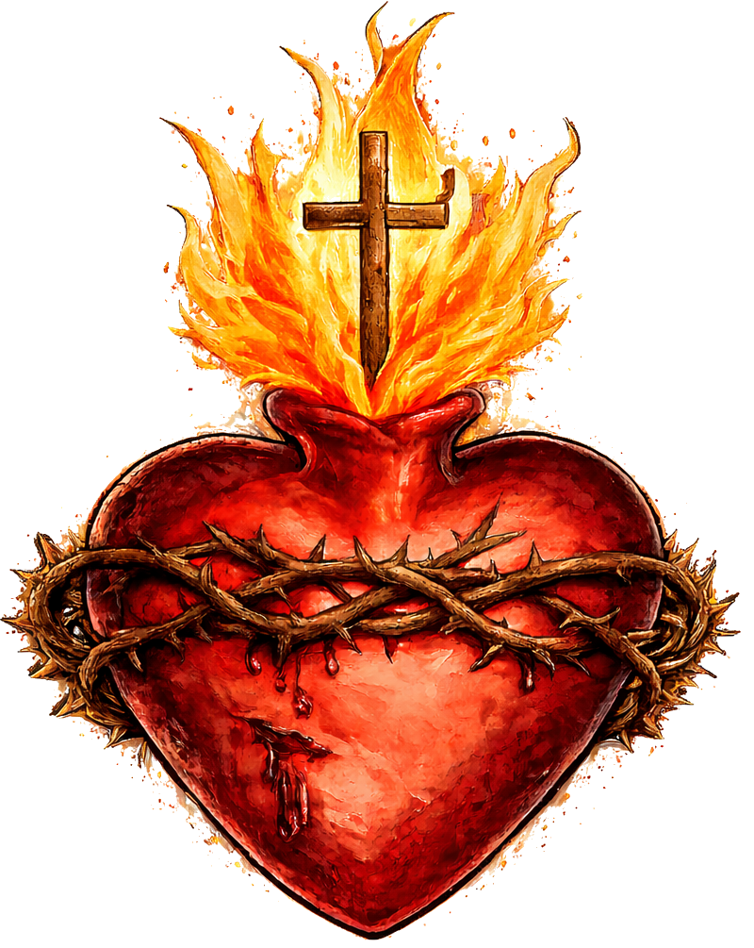
Cognitive Cards:
Judaism Practices
PhilosophyStudent.co.uk

Slide 2
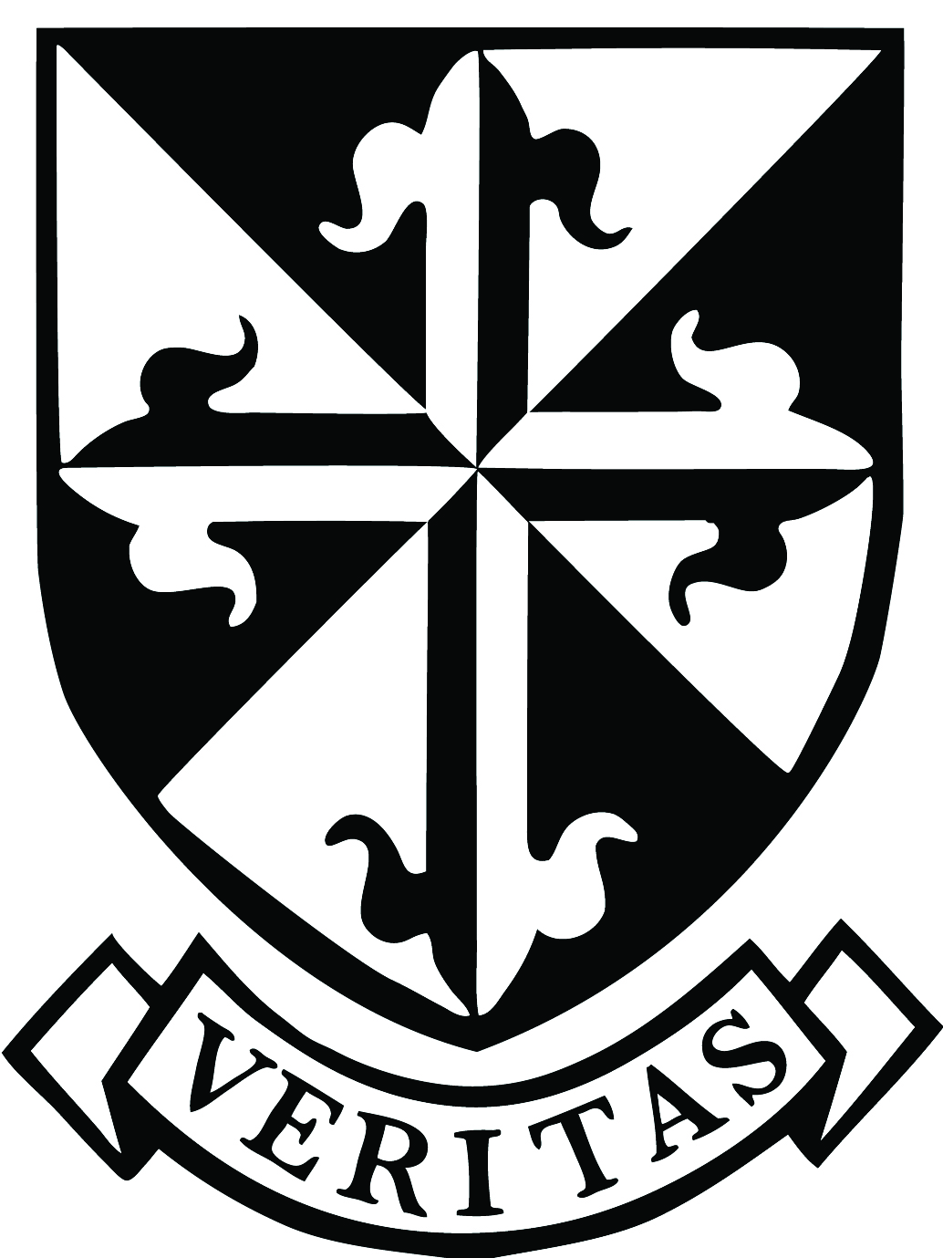
Component 3.2 Judaism Practices:
1) Orthodox & Reform Synagogue Services
2) Worship in the home
3) Items Worn in worship
4) The Synagogue
5) Brit Milah & Bar/Bat Mitzvah
6) Marriage & Mourning
7) The Tenakh & Talmud
8) Kosher Laws
9) Rosh Hashanah & Yom Kippur
10) Pasach & Sukkot
3 Months before exam | Month before exam | Week before exam
* 1 = I know it very well, 2 = I can answer some of the questions, 3 = I need to do more revision

Slide 3
1) Orthodox & Reform Synagogue Services
(b) Describe how Jews prayer at the synagogue. [5]
Tracker

Slide 4
P: Jews often pray together as a community in the synagogue.
E: - Some prayers require a minyan: 10 adult men in Orthodox Judaism;
- in Reform Judaism this can include men and women.
-Jews use the siddur (Jewish prayer book).
E: - Communal prayer strengthens the Jewish community and helps Jews feel closer to God.
P: Synagogue worship includes important set prayers and Torah readings.
E: - Jews recite prayers such as the Shema, Amidah and Kaddish.
- During Shabbat services, passages from the Torah are read and the rabbi may give a sermon explaining them.
E: - Prayer allows Jews to praise, thank and ask God for help.
- Torah readings remind Jews of God’s laws and how they should live.

Slide 5
1) Orthodox & Reform Synagogue Services
(b) Describe what happens during the Amidah. [5]
Tracker

Slide 6
P: The Amidah is one of the most important Jewish prayers.
E: - Amidah means “standing”.
- Jews stand to show they are in God’s presence and face towards Israel/Jerusalem.
E: - It is prayed silently by the congregation.
- Many jews believe they are in the Prescence of God when they pray it. (Shekhinah)
P: The Amidah contains different types of prayer.
E: It is made up of 19 blessings including praise, requests and thanksgiving.
E: - Jews praise God, ask for help and guidance, and thank God for his blessings.
-At the end, Jews take three steps backwards and forwards as they symbolically leave God’s presence.

Slide 7
1) Orthodox & Reform Synagogue Services
(c) Explain how worship in orthodox and reform synagogues is different. [8]
Tracker

Slide 8
P: Orthodox and Reform Jews use different languages in worship.
E: Orthodox services are mainly in Hebrew, while Reform services use more English alongside Hebrew.
E: - Orthodox Jews value Hebrew as the traditional holy language.
- Reform Jews often use more English so the congregation can understand and participate more easily.
P: Men and women have different roles in Orthodox and Reform worship.
E: - In Orthodox synagogues, men and women sit separately and the rabbi is usually male.
- In Reform synagogues, men and women sit together and rabbis can be male or female.
E: - Orthodox worship follows more traditional gender roles.
- Reform Judaism gives men and women equal participation.
P: The Orthodox and Reform synagogues pray in different ways
E: - Orthodox Judaism minyan requires 10 adult men for a minyan.
- Reform Judaism can men and women can pray in a minyan.
E: - This affects who can take part in certain prayers and Torah readings.
- Shows Reform worship has adapted traditional practice to reflect equality between men and women.
P: Music and the style of services are different.
E: - Orthodox services usually have unaccompanied singing and no instruments.
- Reform services may use instrumental music and mixed choirs.
E: - Orthodox Jews preserve traditional forms of worship.
- Reform services are often shorter and more adapted to modern life.

Slide 9
2) Worship in the home
(b) Describe how Jews celebrate Shabbat. [5]
Tracker

Slide 10
P: Jews celebrate Shabbat from Friday evening until Saturday night as a day of rest and worship.
E: - Ten Commandments: “Remember the Sabbath day and keep it holy.”
- Before Friday sunset, the home is prepared and the woman of the family lights two candles to welcome Shabbat.
E: - Orthodox Jews avoid work, such as driving or using electricity.
- Many families attend the synagogue Saturday morning.
P: Jews celebrate Shabbat through a special family meal and rituals.
E: - The Kiddush prayer is said over wine.
- Two challah loaves remember the double portion of manna God provided in the desert.
E: -These rituals separate Shabbat from the rest of the week and dedicates it to time for family, rest and closeness to God.

Slide 11
2) Worship in the home
(c) Explain the importance of Shabbat in Judaism. [8]
Tracker

Slide 12
P: Shabbat is important because keeping it is a mitzvah given by God.
E: Ten Commandments: “Remember the Sabbath day and keep it holy.”
- Moses covenant with God
E: - Keeping Shabbat shows obedience to God and faithfulness to the covenant.
- Orthodox Jews may avoid work completely to keep the commandment. (No driving)
P: Shabbat is important because it reminds Jews that God is Creator.
E: In Genesis, God created the world in six days and rested on the seventh.
E: - Jews imitate God by resting from work.
- Gives time to appreciate God’s creation and thank God for providing for them.
P: Shabbat is important because it reminds Jews of their freedom and history.
E: - Jews remember God freeing the Israelites from slavery in Egypt.
- Two challah loaves remember the double portion of manna God provided in the desert.
E: - Reminds Jews that God protected and provided for their ancestors.
- Strengthens Jewish identity and their connection with previous generations.
P: Shabbat is important because it provides spiritual renewal and time together.
E: Shabbat is a weekly day of rest, prayer and family time.
E: - Jews can put aside ordinary worries and focus on God.
- Families eat together and many Jews worship together at the synagogue.
- Strengthens both the family and Jewish community.
- Some Jews describe it as a taste of Olam

Slide 13
2) Worship in the home
(c) Explain ways in which Jews worship at home. [8]
Tracker

Slide 14
P: Jews worship at home through daily prayer.
E: Many Orthodox Jews say the Modeh Ani when they wake up, thanking God for returning their soul after sleep.
E: - Starts the day by praising and thanking God.
- Reminds Jews that life is a gift from God.
- Helps Jews develop a personal relationship with God.
P: Jews worship at home by using the siddur and reciting the Shema.
E: The siddur contains set daily prayers, including the Shema: “The LORD our God, the LORD is one.”
E: - Reminds Jews of monotheism.
- Helps Jews pray in the same way as the wider Jewish community, even when at home.
- The Shema reminds Jews to remain faithful to God and the mitzvot.
P: Jews worship at home through the mezuzah.
E: - Small Box that contains Shema prayer on every door post (Except the toilet)
- Deuteronomy: “Inscribe them on the doorposts of your house.”
E: - Jews may touch it and kiss their fingers as they pass.
- Reminds the family to love God and live according to his commandments throughout daily life.
P: Jews worship at home by celebrating Shabbat.
E: - Shabbat from Friday evening until Saturday night as a day of rest and worship.
- Ten Commandments: “Remember the Sabbath day and keep it holy.”
E: - Makes the home a place of worship and holiness.
- Gives families time to rest, pray and focus on God together.
- Helps Jews follow Gods commandments

Slide 15
2) Worship in the home
(d) ‘Shabbat is the most important celebration for Jews’. [15]
Tracker

Slide 16
P: Some Jews agree: Shabbat is the most important celebration because keeping it is a commandment from God.
E: Ten Commandments: “Remember the Sabbath day and keep it holy.”
E: - Shabbat is part of the Mosaic covenant.
- Jews show obedience to God by resting and worshipping.
L: Therefore, Shabbat could be the most important celebration because it is directly commanded by God.
P: Some Jews disagree: Yom Kippur may be more important because it is the holiest day of the Jewish year.
E: Yom Kippur is the “Day of Atonement” and a day Jews repent for sins.
E: - Jews may fast and spend much of the day in prayer.
- They ask God and other people for forgiveness.
- Synagogues may hold five prayer services, ending with Neillah.
L: Therefore, Yom Kippur could be more important because it focuses on repentance and restoring the relationship with God.
P: Some Jews agree: Shabbat brings family together and time to worship God.
E: - At home Jews light two Shabbat candles, say Kiddush prayer over wine and share two challah loaves.
- Some Jews describe Shabbat as a “taste of Olam Ha-Ba” — the world to come.
E: - Shabbat allows Jews to stop ordinary work and focus on God.
- The family celebrates and worships together, helping pass Judaism to the next generation.
L: Therefore, Shabbat could be the most important celebration because it regularly strengthens a Jew’s relationship with God, family and community.
P: Some Jews disagree: Pesach could be more important because it remembers one of the most important events in Jewish history.
E: Exodus: Jews are commanded to remember their escape from slavery in Egypt.
E: - The Seder meal retells the Exodus using the Haggadah.
- Foods such as matzah and bitter herbs help Jews remember slavery and freedom.
- Pesach reminds Jews how God rescued and protected the Israelites.
L: Therefore, Pesach could be the most important celebration because it remembers the freedom and origins of the Jewish people.
In conclusion, the strongest argument is …. Because …

Slide 17
3) Items Worn in worship
(b) Describe two religious items worn for Jewish worship. [5]
Tracker

Slide 18
P: Tallit, a Jewish prayer shawl.
E: - It has tzitzit (fringes) attached to its corners.
- Commanded to wear fringes to “remember all the commandments.”
E: - The tzitzit remind Jews of the 613 mitzvot.
- Wearing the tallit helps Jews focus on God and obedience to his laws during prayer.
P: Tefillin.
E: - Tefillin are two small leather boxes containing passages from the Shema.
- One is strapped to the head and one to the arm near the heart.
E: - The box on the head reminds Jews to serve God with their thoughts.
- The box near the heart reminds Jews to serve God through their love and actions.
- Traditionally worn by Orthodox Jewish men during weekday morning prayer.

Slide 19
3) Items Worn in worship
(c) Explain the importance of items worn during Jewish worship. [8]
Tracker

Slide 20
P: kippah is important because it shows respect for God.
E: It is worn on the highest point of the head, reminding Jews that God is above them.
E: - Shows God is greater than humans and deserves respect.
- Helps Jews approach prayer with humility and reverence.
P: The tallit and tzitzit are important because they remind Jews to follow the mitzvot.
E: - The tzitzit represent the 613 mitzvot.
- Book of Numbers: Jews should wear fringes so they can “remember all the commandments.”
E: - Reminds Jews that worship should affect how they live every day.
- Shows obedience to God’s law (The Mitzvot).
P: Tefillin are important because they remind Jews to love and serve God with their whole self.
E&E: - The box on the HAED reminds Jews to serve God with their thoughts.
- The box near the HEART reminds Jews to serve God through love and actions.
- The boxes contain passages from the Shema, connecting worship to belief in one God.
P: Items worn for worship are important because they strengthen Jewish identity.
E: The kippah has become a recognisable symbol of Judaism and many Jews wear it with pride.
E: - Visibly shows that the wearer is Jewish.
- Connects Jews with Jewish tradition and previous generations.
- Helps make religious belief a visible part of everyday life.

Slide 21
3) Items Worn in worship
(d) “Items for Jewish worship should only be worn by men”. [15]
Tracker

Slide 22
P: Some Orthodox Jews agree: items such as tallit and tefillin are traditionally worn by men.
E: - Mishnah: women are exempt from reciting the Shema and wearing tefillin.
- The Mishnah forms part of the Talmud.
E: - Tefillin are normally worn by Orthodox Jewish men during weekday morning prayer.
L: Therefore, some Orthodox Jews would argue these worship items should remain part of male religious responsibility.
P: Many Reform Jews disagree: women should be able to wear the same worship items as men.
E: In Reform Judaism, both men and women may wear tallit, tefillin and kippah.
E: - Reform Judaism emphasises equality between men and women in worship.
- Women can also be rabbis, sit with men and count in a minyan.
L: Therefore, Reform Jews may argue worship items should be available to both men and women equally.
P: Some Orthodox Jews agree: men and women are equal but have different religious roles.
E: - MEN: Tallit and tefillin are traditionally connected with male religious duties.
- WOMEN: Lighting the Shabbat candles is traditionally associated with women in the home.
E: - In Orthodox synagogues, men and women traditionally sit separately.
- Different roles do not necessarily mean one is more important than the other.
L: Therefore, some Orthodox Jews may argue that only men should wear these items because men and women have different responsibilities.
P: Other Jews disagree: the Talmud shows that women wearing worship items is not completely forbidden.
E: Talmud: Mikhal, daughter of King Saul, wore tefillin.
E: - Gives an example of a Jewish woman wearing tefillin from the Talmud.
- Numbers commands Jews to wear tzitzit but does not explicitly say the command is only for men.
- This can support women choosing to wear these items as an expression of faith and commitment to God.
L: Therefore, there is Jewish evidence for allowing women as well as men to wear items for worship.
In conclusion, the strongest argument is …. Because …

Slide 23
4) The Synagogue
(b) Describe two features of a synagogue. [5]
Tracker

Slide 24
P: One important feature is the Aron Hakodesh (Holy Ark).
E: - It is the holiest place in the synagogue and contains the Torah scrolls.
- It is placed on the wall facing Jerusalem.
E: - Keeping the Torah here shows its importance and holiness.
- Jews face towards the Ark and Jerusalem during prayer.
P: Another important feature is the bimah, a raised platform where the Torah is read.
E: - The Torah scroll is placed on the bimah and read to the congregation.
E: - Makes the Torah the focus of the service.
- Shows the importance of God’s teachings and mitzvot in Jewish life.
Alternative:
P: Ner tamid (Eternal lamp) that hangs by the ark and is kept constantly burning.
E: Exodus: Israelites were told to keep a lamp burning ‘from evening to morning before the LORD’ (Exodus).
E: - It symbolises the menorah (7-branched lamp) that was kept burning in the ancient Jerusalem Temple.
- Showing God is with them

Slide 25
4) The Synagogue
(C) Explain some of the differences between Orthodox and Reform Synagogues. [8]
Tracker

Slide 26
P: Orthodox and Reform synagogues have different seating arrangements.
E: - Orthodox synagogues: men and women sit separately, sometimes with women in an upstairs gallery.
- Reform synagogues: men and women sit together.
E: - Orthodox Judaism traditionally gives men and women different religious roles.
- Reform Judaism emphasising equal participation in worship.
P: The bimah is often positioned differently.
E: - Orthodox synagogue: the bimah is usually in the centre of the congregation.
- Reform synagogue, it is usually at the front, near the Aron Hakodesh.
E: In both, the Torah is read from the bimah, showing the importance of God’s word.
P: Orthodox and Reform synagogues have different rules about the minyan.
E: - Orthodox Judaism requires 10 adult men.
- Reform Judaism: men and women to make up the minyan.
E: - A minyan is needed for certain communal prayers.
- Reform emphasis on equality between men and women.
P: Men and women can have different leadership roles.
E: - Orthodox synagogues traditionally have a male rabbi.
- Reform synagogues may have a male or female rabbi.
E: - Orthodox Judaism preserves traditional male religious responsibilities.
- Reform Judaism allows women to take an equal role in leading the community and worship.

Slide 27
4) The Synagogue
(b) Explain why the Synagogue is important in Judaism [8]
Tracker

Slide 28
P: The synagogue is important because it is a place of worship – Bet Tefilah, “house of prayer.”
E: - Jews gather there for Shabbat services and prayers such as the Shema, Amidah and Kaddish.
- Ten Commandments: “Remember the Sabbath day and keep it holy.”
E: - Allows Jews to worship God together.
- Helps Jews develop their relationship with God and keep the mitzvot.
P: The synagogue is important because it is a place of study – Bet Midrash, “house of study.”
E: - Jews study the Torah and Tenakh there.
- Children may learn Hebrew and prepare for their Bar/Bat Mitzvah.
E: - Helps Jews understand God’s laws and teachings.
- Passes Jewish beliefs and traditions to the next generation.
P: The synagogue is important because it brings the Jewish community together – Bet Knesset, “house of assembly.”
E: - Certain prayers require a minyan (10 Adults to pray).
- Synagogues also organise charity events, celebrations and activities for the community.
E: -Gives Jews a sense of belonging and Jewish identity.
- Allows the community to support one another, particularly at important times such as mourning.
P: The synagogue is important because it connects Jews with the Temple and Jewish history.
E: After the Temple was destroyed in 70 CE, sacrifices stopped and synagogue prayer became central to Jewish worship.
E: - Daily prayers developed as a replacement for the sacrifices offered in the Temple.
- The Aron Hakodesh faces Jerusalem, keeping a connection with the Temple.
- Reminds Jews of their history and covenant with God.

Slide 29
4) The Synagogue
(d) ‘You have to go to the synagogue to a Jew’. [15]
Tracker

Slide 30
P: Some Jews agree: the synagogue is important because Judaism values communal worship.
E: - Jews gather for prayers such as the Shema, Amidah and Kaddish.
- Some communal prayers require a minyan (10 adult men in Orthodox Judaism; Reform Judaism can include men and women.)
E: - Worshipping together strengthens a Jew’s relationship with God.
- It also creates a strong sense of Jewish community and identity.
L: Therefore, some Jews may argue that regularly attending synagogue is an important part of living as a Jew.
P: Other Jews disagree: Jews can worship God at home and do not need a synagogue to practise their faith.
E: - Jews can use the siddur (Jewish prayer book) and recite the Shema at home.
- A mezuzah containing the Shema is placed on Jewish doorposts.
E: - We can worship God at home and daily life, not only inside a synagogue.
- Jews can develop a personal relationship with God wherever they are.
L: Therefore, going to synagogue is not necessary in order to worship or live as a Jew.
P: Some Jews agree: the synagogue is important for passing Judaism to the next generation.
E: The synagogue is a Bet Midrash – “house of study.”
E: - Children learn Hebrew and Torah there.
- They may prepare for their Bar or Bat Mitzvah in the synagogue.
- Synagogues also organise festivals, charity and activities for Jewish families.
L: Therefore, attending synagogue can be important because it helps preserve Jewish beliefs, traditions and identity.
P: Other Jews disagree: being Jewish is about following Jewish beliefs and practices, not simply attending a building.
E: - Jews can keep Shabbat at home by lighting candles, saying Kiddush and sharing challah.
- The Ten Commandments say: “Remember the Sabbath day and keep it holy” — they do not say a Jew must be inside a synagogue to do this.
E: - Jews can follow the mitzvot, keep kosher, pray and celebrate festivals outside the synagogue.
- The home is a major centre of Jewish religious life.
L: Therefore, a person can live a committed Jewish life even if they do not regularly attend synagogue.
In conclusion, the strongest argument is …. Because …

Slide 31
5) Brit Milah & Bar/Bat Mitzvah
(b) Describe two features of Bar Mitzvah ceremony. [5]
Tracker

Slide 32
Def: Bar Mitzvah means “Son of the Commandment” and is a Jewish coming-of-age ceremony which usually takes place on the Shabbat after a boy’s 13th birthday.
P: One feature is that the boy reads from the Torah.
E: He is called to the bimah and reads a prepared passage from the Torah in front of the congregation.
E: - Shows he is now able to take a fuller part in synagogue worship.
- It marks that he is now responsible for keeping the mitzvot himself.
P: Another feature is that the boy takes on the responsibilities of a Jewish adult.
E: - He may wear tefillin for the first time and give a speech to the congregation.
- His father says a blessing thanking God that his son has reached maturity.
E: - After Bar Mitzvah, he can be counted in an Orthodox minyan.
- Shows he is now personally responsible for his actions and Jewish duties.

Slide 33
5) Brit Milah & Bar/Bat Mitzvah
(b) Describe two features of Brit Milah Ceremony. [5]
Tracker

Slide 34
Def: Brit Milah means the “covenant of circumcision” and is a ceremony for a Jewish baby boy, usually held when he is 8 days old, to welcome him into the Abrahamic covenant.
P: One feature is that the baby boy is circumcised by a mohel.
E: The mohel is specially trained to carry out the circumcision.
E: - Circumcision is the physical sign of the covenant God made with Abraham.
- It shows the child is entering the Jewish community and covenant with God.
P: Another feature is that the child is blessed and welcomed into the community.
E: - The baby may be placed on Elijah’s chair, because Elijah is believed to be present at every Brit Milah.
- The child is then blessed and given his Hebrew name, followed by a celebration.
E: - This welcomes the child into Jewish life and identity.
- The blessings express hopes that he will grow to follow the Torah, relationships and good deeds.

Slide 35
5) Brit Milah & Bar/Bat Mitzvah
(b) Describe two features of a Jewish girl’s coming-of-age ceremony. [5]
Tracker

Slide 36
Def: A Jewish girl’s coming-of-age ceremony marks the point when she becomes responsible for her own Jewish duties and actions. Reform Jews usually celebrate a Bat Mitzvah, while Orthodox girls may have a Bat Chayil.
P: In Reform Judaism, girls usually celebrate a Bat Mitzvah at around 12 or 13 years old.
E: - The ceremony can be very similar to a boy’s Bar Mitzvah.
- The girl may read from the Torah, give a speech and take a full part in the synagogue service.
E: - This reflects Reform Judaism’s belief in equality between men and women.
- After the ceremony, she is responsible for keeping the mitzvot.
P: In Orthodox Judaism, girls may celebrate a Bat Chayil, usually around the age of 12.
E: - Bat Chayil means “Daughter of worth.”
- The girl may give a speech about Judaism, but traditionally does not read from the Torah during the service.
E: - This marks her taking on an adult role in the Jewish community.
- It reflects the Orthodox belief that men and women have different religious roles.

Slide 37
5) Brit Milah & Bar/Bat Mitzvah
(c) Explain why Brit Milah is important for Jews. [8]
Tracker

Slide 38
P: Brit Milah is important because it is the sign of the Abrahamic covenant.
E: Genesis: “Every male among you shall be circumcised at the age of eight days.”
E: - Circumcision is the physical sign of the agreement between God and Abraham.
It shows the child is part of the special relationship between God and the Jewish people.
P: Brit Milah is important because it shows obedience to God.
E: God commanded Abraham that his male descendants should be circumcised on the eighth day.
E: Jews continue to follow a command given in the Torah thousands of years later.
Shows commitment to God’s mitzvot even from the beginning of a child’s life.
P: Brit Milah is important because it welcomes the child into the Jewish community and identity.
E: During the ceremony, the baby is blessed and given his Hebrew name.
E: Publicly identifies the child as part of the Jewish people.
Family and community celebrate together, strengthening a sense of belonging.
P: Brit Milah is important because it helps ensure the continuity of Judaism.
E: The command in Genesis is to be followed “throughout the generations.”
E: - Each new generation enters the same covenant as Abraham.
- It connects Jews today with their ancestors and Jewish history.
- A male convert may also undergo Brit Milah, showing its importance in entering the covenant.

Slide 39
6) Marriage & Mourning
(b) Describe a Jewish marriage ceremony. [5]
Tracker

Slide 40
Def: A Jewish marriage is a religious and legal union between two people, usually carried out under the supervision of a rabbi and involving a ketubah (marriage contract).
P: One feature is that the couple marry under the chuppah.
E: - The chuppah is a canopy which symbolises the home the couple will build together.
E: - Shows the couple are beginning a new life together.
- In Reform Judaism, rings may be exchanged by both partners to show equality.
(Orthodox: only the groom gives a ring to the bride during the wedding ceremony.)
P: Another feature is the signing of the ketubah and the breaking of a glass.
E: The ketubah sets out the couple’s rights and responsibilities within marriage.
- At the end of the ceremony, the groom traditionally stamps on a glass.
E: - The ketubah shows marriage involves commitment and responsibility.
- The broken glass remembers the destruction of the Temple in Jerusalem, linking the couple to Jewish history.

Slide 41
6) Marriage & Mourning
(b) Describe two ways of Jewish mourning. [5]
Tracker

Slide 42
Def: Jewish mourning follows a number of stages and rituals which help the family show respect for the dead and cope with their loss.
P: One way Jews mourn is through Shiva, the first seven days after burial.
E: - Mourners usually stay at home, sit on low chairs, cover mirrors and receive visitors.
- The Kaddish prayer is said and a candle may be kept lit.
E: - Shiva allows the family to focus fully on grieving and remembering the person who has died.
- The wider Jewish community can support them during this difficult time.
P: Another way Jews mourn is through Shloshim and Yahrzeit.
E: - Shloshim: further 30-day period of mourning when mourners avoid celebrations.
- Yahrzeit: yearly anniversary of the death, candle is lit and the Kaddish is said.
E: - These practices ensure the dead continue to be remembered and honoured.
- They allow mourning to continue gradually rather than ending immediately after the funeral.

Slide 43
6) Marriage & Mourning
(c) Explain why mourning rituals are important in Judaism. [8]
Tracker

Slide 44
P: Mourning rituals are important because they show respect and dignity for the person who has died.
E: The chevra kaddisha wash the body, dress it in simple white clothing and prepare it for burial.
E: - Shows the dead should be treated with care and honour.
- Simple funeral = all people are equal in death.
- Burial usually takes place as soon as possible, showing respect for the deceased.
P: Mourning rituals are important because they help the family grieve properly.
E: During Shiva, mourners stay at home for seven days, sit on low chairs and avoid normal activities.
E: - Gives the family time to focus on their loss and emotions.
- Prevents them having to return immediately to ordinary life.
- Helps mourning happen gradually.
P: Mourning rituals are important because they provide support from the Jewish community.
E: During Shiva, friends and relatives visit the mourners, and the Kaddish is recited.
E: - The community helps with practical needs so the family can focus on grieving.
- Shows that Jews are not left alone in suffering.
- Strengthens the sense of Jewish community and belonging.
P: Mourning rituals are important because they help Jews remember the dead and remain connected to God.
E: On Yahrzeit, the yearly anniversary of the death, Jews light a candle and say the Kaddish.
E: - Keeps the memory of the person alive.
- Prayer can help mourners feel closer to God during grief.
- Shows that remembering and honouring the dead continues long after the funeral.

Slide 45
7) The Tenakh & Talmud
(b) Describe how the Tenakh is used by Jews. [5]
Tracker

Slide 46
Def: The Tenakh is the Jewish Bible and is made up of the Torah, Nevi’im (Prophets) and Ketuvim (Writings). The Torah is the most important part because it contains the mitzvot given by God.
P: Jews use the Tenakh to guide how they live their daily lives.
E: - The Torah contains the mitzvot, which teach Jews how to act, worship and live morally.
- Jews may study the Tenakh at home, in the synagogue or at a yeshiva.
E: - Helps Jews understand what God expects of them.
- Following its teachings helps Jews remain faithful to their covenant with God.
P: Jews also use the Tenakh in worship and prayer.
E: - Passages from the Torah are read aloud during synagogue services.
- The Ketuvim (Jewish prayer book) contains the Psalms, which are used in Jewish prayer and worship.
E: - Torah readings remind Jews of God’s laws and teachings.
- Using the Tenakh in worship helps Jews feel closer to God and connected to the Jewish community.

Slide 47
7) The Tenakh & Talmud
(b) Describe the importance of the Talmud for Jews. [5]
Tracker

Slide 48
Def: The Talmud is a collection of Jewish teachings made up of the Mishnah and the Gemara.
P: The Talmud is important because it helps Jews understand and apply the Torah.
E: - The Mishnah records teachings about how the laws of the Torah should be interpreted.
- The Gemara contains further discussion by rabbis.
E: Helps Jews understand how to follow the mitzvot in everyday life.
Gives guidance where the Torah may not explain exactly how a law should be applied.
P: The Talmud is important because it is a major source of Jewish study and religious authority.
E: - Many Orthodox Jews study the Torah and Talmud (Jewish academies).
- The Talmud contains debates and teachings from important rabbis.
E: Studying it helps Jews develop a deeper understanding of Jewish law and belief.
It connects Jews with generations of Jewish interpretation and tradition.

Slide 49
7) The Tenakh & Talmud
(b) Describe the importance of the Talmud for Jews. [5]
Tracker

Slide 50
Def: The Talmud is a collection of Jewish teachings made up of the Mishnah and the Gemara.
P: The Talmud is important because it helps Jews understand and apply the Torah.
E: - The Mishnah records teachings about how the laws of the Torah should be interpreted.
- The Gemara contains further discussion by rabbis.
E: Helps Jews understand how to follow the mitzvot in everyday life.
Gives guidance where the Torah may not explain exactly how a law should be applied.
P: The Talmud is important because it is a major source of Jewish study and religious authority.
E: - Many Orthodox Jews study the Torah and Talmud (Jewish academies).
- The Talmud contains debates and teachings from important rabbis.
E: Studying it helps Jews develop a deeper understanding of Jewish law and belief.
It connects Jews with generations of Jewish interpretation and tradition.

Slide 51
8) Kosher Laws
(b) Describe Jewish beliefs about Kosher. [5]
Tracker

Slide 52
Def: Kosher means “fit” or “proper” and refers to food that Jews are permitted to eat according to the dietary laws found mainly in the Torah.
P: Jews believe God gave rules about which foods may and may not be eaten.
E: Leviticus: animals must have split hooves and chew the cud; fish must have fins and scales.
E: - Foods allowed by Jewish law are kosher; forbidden foods are treyfah.
- For example, pork and shellfish are not kosher.
- Keeping these rules shows obedience to God’s mitzvot.
P: Jews also believe kosher food must be prepared correctly.
E: Exodus: “You shall not boil a kid in its mother’s milk.”
E: - Meat and dairy are kept separate and are not eaten together.
- Many Orthodox Jews use separate plates, cutlery and preparation areas for meat and dairy.

Slide 53
8) Kosher Laws
(c) Explain why some Jews keep kosher dietary laws. [8]
Tracker

Slide 54
P: Kosher laws are mitzvot given by God in the Torah.
E: Leviticus: animals must have split hooves and chew the cud, and fish must have fins and scales.
E: - Keeping kosher shows obedience to God.
- Orthodox Jews especially may believe these laws remain eternally binding.
- Following them helps Jews remain faithful to the covenant.
P: Some Jews keep kosher because it strengthens their Jewish identity and connection with tradition.
E: Jews have followed Kosher laws for generations.
E: - Eating kosher connects Jews with their ancestors and Jewish history.
- It makes Judaism a visible part of daily life.
- Passing these practices on helps preserve Judaism for the next generation.
P: Some Jews keep kosher because it reminds them to put God at the centre of everyday choices.
E: Exodus: “You shall not boil a kid in its mother’s milk.”
E: - Meat and dairy are kept separate, sometimes using different plates and cutlery.
- This turns an ordinary activity like eating into an act of religious obedience.
P: Some Jews keep kosher because it strengthens the Jewish community.
E: Jewish families and communities may eat the same kosher foods and follow the same dietary rules.
E: - Shared practices create a sense of belonging and unity.
- Kosher meals allow Jews to celebrate Shabbat and festivals together while following Jewish law.
- It acts as a physical expression of their shared faith.

Slide 55
8) Kosher Laws
(d) “Keeping kosher is not important for Jews today.” [15]
Tracker

Slide 56
P: Many Orthodox Jews disagree: keeping kosher is important because the dietary laws are mitzvot given by God in the Torah.
E: Leviticus: animals must have split hooves and chew the cud, while fish must have fins and scales.
E: - Keeping kosher shows obedience to God and faithfulness to the covenant.
L: Therefore, keeping kosher is important because it is part of God’s law.
P: Some Jews agree: keeping kosher can be difficult and impractical in modern life.
E: - Kosher food can be more expensive and difficult to find, especially outside large Jewish communities.
- There may be few kosher restaurants, and Orthodox kitchens may need separate plates and utensils for meat and dairy.
E: - This can make eating with friends, travelling or eating out much harder.
- Some Reform Jews therefore choose to keep only some kosher laws or keep kosher mainly at home.
L: Therefore, some Jews may believe strict kosher observance is less important in modern life.
P: Other Jews disagree: keeping kosher is important because it strengthens Jewish identity and commitment to God.
E: Exodus: “You shall not boil a kid in its mother’s milk.”
E: - This is why many Jews keep meat and dairy separate.
- Every meal becomes a reminder of Jewish faith and God’s commandments.
- Following the same traditions as previous generations connects Jews with their history and community.
L: Therefore, keeping kosher remains important because it makes Judaism part of everyday life.
P: Some Jews agree: other Jewish practices may be more important than keeping kosher.
E: - The Ten Commandments contain major duties such as worshipping only God and “Remember the Sabbath day and keep it holy.”
- Jews celebrate Shabbat every week through rest, prayer, family worship and synagogue attendance.
E: - Shabbat directly strengthens a Jew’s relationship with God, family and community.
- The Ten Commandments also contain fundamental moral laws such as do not murder and do not steal.
- A Jew may therefore see worshipping God and living morally as more important than dietary rules.
L: Therefore, keeping kosher may be important, but some Jews could argue that Shabbat and the Ten Commandments are more central to Jewish life.
In conclusion, the strongest argument is …. Because …

Slide 57
9) Rosh Hashanah & Yom Kippur
(b) Describe the origins and meaning of Rosh Hashanah. [5]
Tracker

Slide 58
Def: Rosh Hashanah is the Jewish New Year and begins the Ten Days of Repentance leading to Yom Kippur.
P: Rosh Hashanah celebrates God creating the world.
E: - Leviticus describes Rosh Hashanah as a day of rest, echoing the Genesis creation story where God rested on the 7th day of creation.
- The day is marked by the blowing of the shofar (ram’s horn).
E: - Reminds Jews that God is Creator and King.
- The shofar calls Jews to reflect and repent as the new year begins.
P: Rosh Hashanah is also the Day of Judgement.
E: - The Mishnah teaches that at Rosh Hashanah, God judges people for how they have lived.
- It begins the Ten Days of Repentance, when Jews ask forgiveness and try to make up for wrongs before Yom Kippur.
E: - Jews reflect on their good and bad actions from the previous year.
- Gives Jews the chance to begin the new year with a fresh start.

Slide 59
9) Rosh Hashanah & Yom Kippur
(b) Describe how Jews celebrate Rosh Hashanah. [5]
Tracker

Slide 60
Def: Rosh Hashanah is the Jewish New Year and begins the Ten Days of Repentance leading to Yom Kippur.
P: Jews celebrate Rosh Hashanah through showing repentance.
E: - The shofar is traditionally blown 100 times as a call to repentance.
- Some Jews perform Tashlick, throwing bread into flowing water to symbolise casting away sins.
E: These practices encourage Jews to reflect on the previous year and prepare to ask forgiveness during the Ten Days of Repentance.
P: Jews also celebrate Rosh Hashanah with special foods and a family meal.
E: - Apples dipped in honey are eaten in hope of a sweet new year.
- A round challah loaf symbolises the cycle of life and the kingship of God.
- Families may say Kiddush over wine and eat together.
E: These traditions make Rosh Hashanah both a time of celebration and a fresh start for the new year.

Slide 61
9) Rosh Hashanah & Yom Kippur
(c) Explain the importance of Rosh Hashanah. [8]
Tracker

Slide 62
P: Rosh Hashanah is important because it is the Day of Judgment.
E: - The Mishnah teaches that at Rosh Hashanah God judges people for how they have lived.
E: - Jews reflect on their good and bad actions from the previous year.
- Encourages Jews to take responsibility for their choices.
- Reminds Jews that God is just but willing to forgive those who repent.
P: Rosh Hashanah is important because it begins a period of repentance and forgiveness.
E: - It starts the Ten Days of Repentance, leading to Yom Kippur.
- The shofar is blown 100 times as a call to repentance.
- Tashlick: Jews may throw pieces of bread into flowing water, symbolically casting away their sins.
E: - Encourages Jews to ask forgiveness and make up for wrongs.
- Gives Jews the opportunity to change their behaviour and make a fresh start.
P: Rosh Hashanah is important because its special foods express Jewish hopes for the new year.
E: - Apples dipped in honey represent the hope for a sweet new year.
- Pomegranates have many seeds, symbolising the hope that Jews will perform many mitzvot in the coming year.
E: - Reminds Jews that the new year is an opportunity to live better and follow God’s commandments.
- Makes important Jewish beliefs memorable through family traditions.
P: Rosh Hashanah is important because it strengthens Jewish family and community life.
E: Jews attend the synagogue and families gather together for special meals and prayers.
E: - Brings Jews together at the beginning of the Jewish New Year.
- Helps families pass Jewish traditions and beliefs to the next generation.
- Strengthens a shared sense of Jewish identity and belonging.

Slide 63
9) Rosh Hashanah & Yom Kippur
(b) Describe the origins and meaning of Yom Kippur. [5]
Tracker

Slide 64
Def: Yom Kippur means the “Day of Atonement” and comes at the end of the Ten Days of Repentance after Rosh Hashanah.
P: Yom Kippur is the holiest day of the Jewish year and originates from God commanding a special Day of Atonement (Making up for wrongdoing).
E: Leviticus describes the sins of the people being symbolically placed onto a goat, which was then sent into the wilderness — the scapegoat.
E:
The goat represented the removal of the people’s sins.
Jews were commanded to set aside this day to repent and seek forgiveness from God.
This helps Jews put right their sins and restore their relationship with God.
P: Yom Kippur means a time of self-denial and a fresh start.
E: Jews practise self-denial by denying themselves food, drink, perfume and sex.
E: - Jews show repentance by fasting and focusing on prayer rather than physical needs.
- Being able to say not to good things like Food and drink helps them say no to sin.
- After genuinely repenting, Jews hope to begin the new year forgiven and reconciled with God and others.

Slide 65
9) Rosh Hashanah & Yom Kippur
(c) Explain how Jews celebrate Yom Kippur. [8]
Tracker

Slide 66
P: Jews celebrate Yom Kippur through fasting and self-denial.
E: - Leviticus: Jews should “practise self-denial.”
- Healthy Jews over Bar/Bat Mitzvah age usually complete a 25-hour fast with no food or drink.
E: - Helps Jews focus on God rather than physical needs.
- Practising saying no to good things, like food and drink, can help Jews develop self-control and resist sin.
P: Jews celebrate Yom Kippur through prayer and synagogue worship.
E: - Many Jews spend much of the day in the synagogue.
- There may be five prayer services instead of the usual three.
- The Aron Hakodesh is opened, symbolising closeness to God and the gates of heaven being open.
E: - Jews ask God for forgiveness and reflect on their actions.
- Shows Yom Kippur is a serious time for repentance and restoring the relationship with God.
P: Jews celebrate Yom Kippur by seeking forgiveness and putting wrongs right.
E: Jews are expected to apologise to people they have wronged as well as asking God for forgiveness.
E: - Encourages Jews to take responsibility for their actions.
- Helps repair relationships with God and other people.
P: Yom Kippur is ended with the Neillah service, the most sacred final prayer service of the day.
E: - Neillah means “closing” and symbolises the closing of the gates of heaven and the final judgment.
- At the very end, the shofar is blown once to show Yom Kippur has finished.
E: - Gives Jews one final opportunity to repent and ask God for forgiveness.
- The closing of the gates reminds Jews that the time for judgement and repentance is ending.
- Jews hope to begin the new year forgiven, reconciled with God and given a fresh start.

Slide 67
9) Rosh Hashanah & Yom Kippur
(d) ‘Rosh Hashanah is more important than Yom Kippur’. [15]
Tracker

Slide 68
P: Some Jews agree: Rosh Hashanah is the Day of Judgement and begins the process of repentance (asking for forgiveness).
E: - It starts the Ten Days of Repentance, leading to Yom Kippur.
- The shofar is blown 100 times as a call to repentance.
- Tashlick: Jews may throw pieces of bread into flowing water, symbolically casting away their sins.
E: - Jews reflect on their good and bad actions from the previous year.
- Encourages Jews to take responsibility for their choices.
L: Therefore, Rosh Hashanah could be more important because it reminds Jews that God is just but willing to forgive those who repent.
P: Other Jews disagree: Yom Kippur may be more important because it allows Jews to receive forgiveness and restore relationships.
E: - Leviticus describes the scapegoat, which symbolically carried the people’s sins away.
- Jews are expected to apologise to people they have wronged as well as asking God for forgiveness.
E: -This allows them to repair relationships and be reconciled with God and others.
- At the end of Yom Kippur, Jews hope to begin again with a clean slate.
L: Therefore, Yom Kippur could be more important because it completes the process of repentance and forgiveness begun at Rosh Hashanah.
P: Some Jews agree: Rosh Hashanah may be more important because it celebrates a new year and God as Creator and King.
E: - Leviticus describes it as a sacred day of rest, echoing God resting after creation in Genesis.
- Apples and honey represent hope for a sweet new year.
- Pomegranates symbolise the hope of completing many mitzvot in the year ahead.
E: - It gives Jews an opportunity for a fresh start and to think about how they will live better.
- It combines celebration with a renewed commitment to God’s commandments.
L: Therefore, Rosh Hashanah could be more important because it shapes how Jews hope to live throughout the whole coming year.
P: Other Jews disagree: Yom Kippur may be more important because it practices God commands to “practise self-denial.”
E: - Leviticus: Jews should “practise self-denial.”
- Healthy Jews over Bar/Bat Mitzvah age usually complete a 25-hour fast with no food or drink.
E: - Helps Jews focus on God rather than physical needs.
- Practising saying no to good things, like food and drink, can help Jews develop self-control and resist sin
L: Therefore, Yom Kippur could be more important because Jews make greater sacrifices to focus completely on God and repentance.
In conclusion, the strongest argument is …. Because …

Slide 69
10) Pasach & Sukkot
(b) Describe Jewish beliefs about Pesach. [5]
Tracker

Slide 70
Def: Pesach (Passover) is the Jewish Festival of Freedom, remembering how God rescued the Israelites from slavery in Egypt.
P: Pesach remembers the Exodus and God freeing the Israelites from slavery.
E: - Exodus: God sent the Ten Plagues on Egypt so Pharaoh would free the Israelites.
- During the final plague (death of the firstborn), Jewish homes marked with lamb’s blood were “passed over.”
E: - Reminds Jews that God rescues, protects and cares for his people.
- Celebrates the Israelites gaining their freedom from slavery.
P: Pesach also remembers the suffering the Jewish people experienced as slaves in Egypt.
E: - The Seder plate contains foods which symbolise their suffering:
- bitter herbs represents the bitterness of slavery.
- Salt water represents the tears of the Israelite slaves.
- Charoset represents the mortar used by slaves when building for the Egyptians.
E: - Helps Jews remember and identify with the suffering of their ancestors.
- Reminds Jews to value their freedom and be grateful to God for rescuing them.
- Can encourage Jews to think about people suffering from oppression today.

Slide 71
10) Pasach & Sukkot
(b) Describe Jewish beliefs about Sukkot. [5]
Tracker

Slide 72
Def: Sukkot remembers the Israelites’ 40 years travelling through the desert after escaping Egypt.
P: Sukkot remembers how the Israelites lived in temporary shelters in the desert.
E: - Sukkot is also known as the “Feast of Tabernacles” or “Feast of Booths.”
- Jewish families build a sukkah, a temporary open-air shelter with a simple roof.
- Many Jews eat and spend time in the sukkah, and some may sleep in it.
E: - Reminds Jews of the hardships their ancestors experienced on the journey to the Promised Land.
- Connects Jews today with their history and the Exodus.
P: Sukkot reminds Jews that God protects and provides for his people.
E: - During the desert journey, the Israelites depended on God for food, water and protection.
- Sukkot is also a harvest festival, when Jews thank God for food and the blessings of creation.
E: - Reminds Jews that their security ultimately comes from God, not possessions.
- Encourages Jews to be grateful for God’s protection and provision.

Slide 73
10) Pasach & Sukkot
(c) Explain why Pesach (Passover) is important to Jews today. [8]
Tracker

Slide 74
P: Pesach is important because it reminds Jews that God rescued the Israelites from slavery in Egypt.
E: - Exodus: God sent the Ten Plagues so Pharaoh would free the Israelites.
- During the final plague, homes marked with lamb’s blood were “passed over.”
E: - Reminds Jews that God protects, saves and cares for his people.
- Strengthens Jewish trust in God and gratitude for freedom.
P: Pesach is important because it helps Jews remember and pass on their history.
E: - During the Seder meal, the Haggadah is used to retell the story of the Exodus.
E: - Helps children learn about the experiences of their ancestors.
- Passes Jewish beliefs and traditions to the next generation.
P: Pesach is important because its symbolic foods make the story memorable.
E: Matzah remembers the Israelites leaving Egypt so quickly that their bread could not rise.
- Maror represents the bitterness of slavery.
- Salt water represents the tears of the slaves.
E: - Helps Jews identify with the suffering and freedom of their ancestors.
- Makes Jewish history something Jews can experience and remember, not just read about
P: Pesach is important because its message of freedom is still relevant today.
E: Jews may use Pesach to think about people suffering from oppression and modern forms of slavery.
E: - Encourages Jews to value their own freedom.
- Can inspire them to help people who are oppressed or treated unjustly.
- Shows that the message of the Exodus can still influence how Jews live today.

Slide 75
10) Pasach & Sukkot
(c) Explain why the festival of Sukkot is important for Jewish people. [8]
Tracker

Slide 76
P: Sukkot is important because it helps Jews remember the Israelites’ journey through the desert.
E: - Jews build a sukkah, a temporary shelter, to remember the booths the Israelites lived in for 40 years.
E: - Reminds Jews of the hardships their ancestors experienced after the Exodus.
- Connects Jews today with their history and the journey to the Promised Land.
P: Sukkot is important because it reminds Jews that God protects and provides for his people.
E: - In the desert, the Israelites depended on God for food, water and protection.
- The sukkah is deliberately temporary and exposed, showing that true security comes from God.
E: - Encourages Jews to trust God rather than possessions.
- Reminds them to be grateful for God’s care and protection.
P: Sukkot is important because it reminds Jews that God is present everywhere.
E: - Jews wave the lulav and etrog in different directions during Sukkot.
- This symbolises God’s omnipresence — that God is everywhere.
E: - Helps Jews remember that God is with them wherever they are.
- Strengthens their relationship with God and trust in him.
P: Sukkot is important because celebrating it is one of the mitzvot commanded by God.
E: Leviticus: Jews are commanded to “live in booths seven days.”
E: - Building and spending time in the sukkah shows obedience to God’s law.
- Keeping Sukkot helps Jews remain faithful to the covenant.
- It shows that remembering Jewish history is not optional, but part of religious duty.

