Slide 1
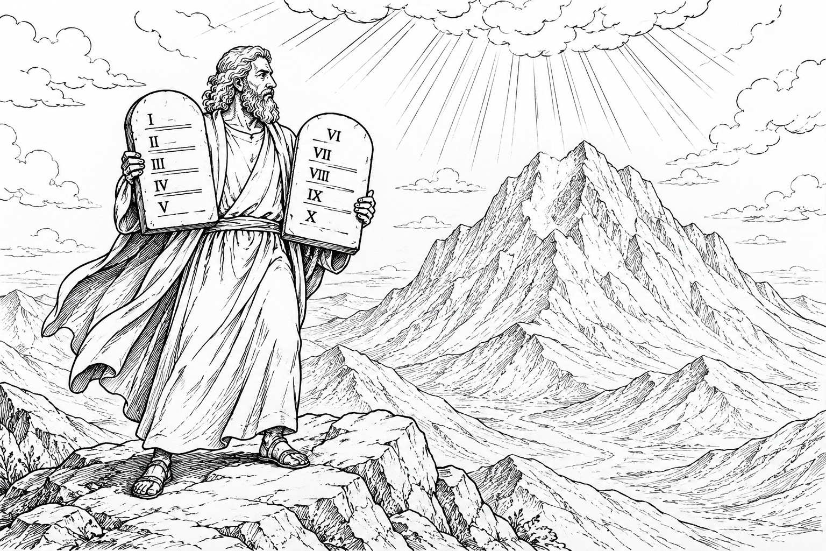
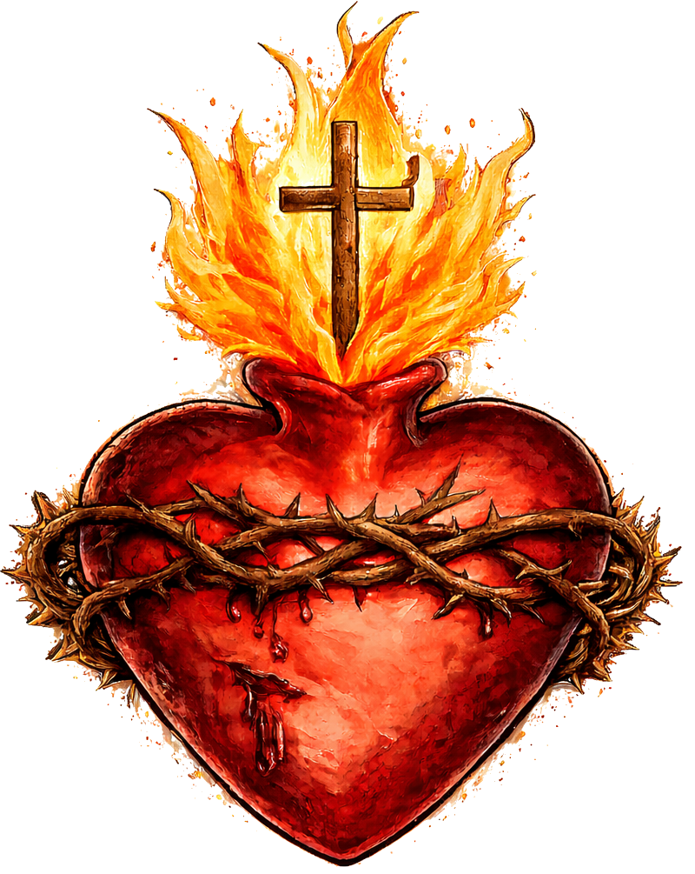
Cognitive Cards:
Judaism beliefs & teachings
PhilosophyStudent.co.uk

Slide 2
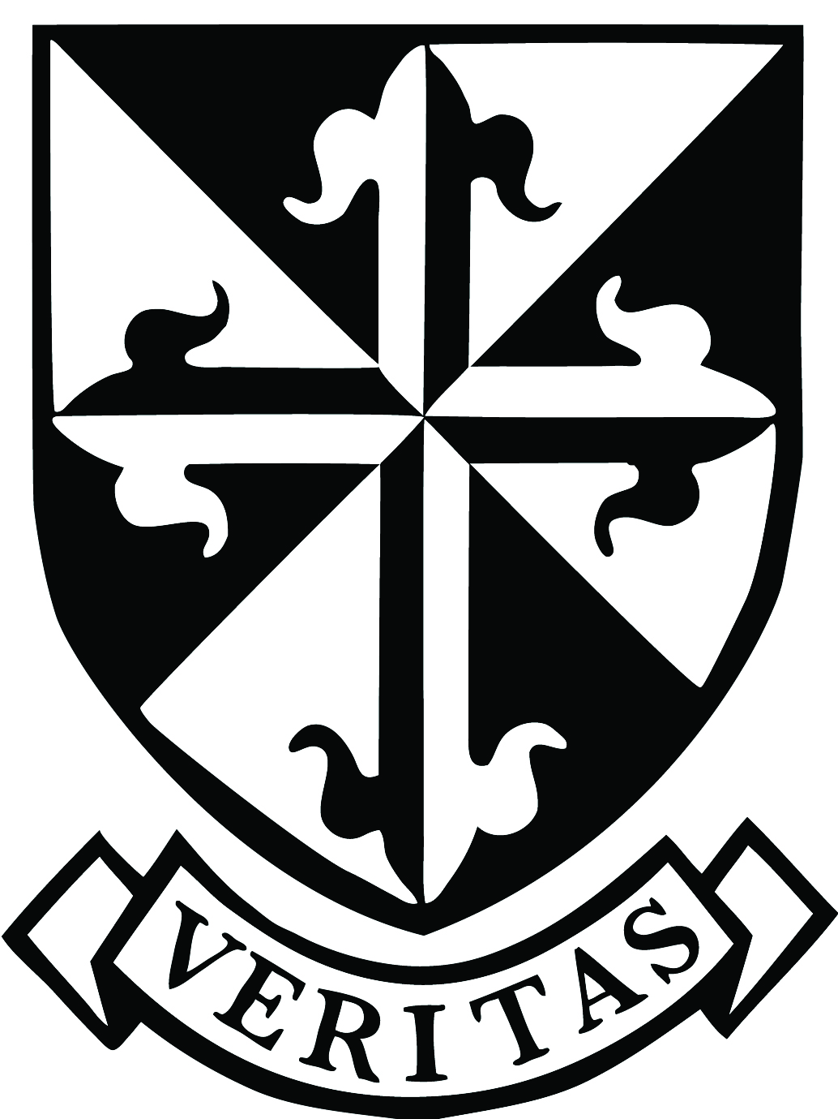
Component 3.1
Judaism beliefs & teachings:
1) The Nature of God
2) Shekhinah
3) The Messiah and Messianic Age
4) The Covenant with Abraham
5) The Covenant with Moses
6) The Sanctity of Life and Pikuach Nefesh
7) Free Will & Mitzvot
8) Jewish Beliefs about Life After Death
3 Months before exam | Month before exam | Week before exam
* 1 = I know it very well, 2 = I can answer some of the questions, 3 = I need to do more revision

Slide 3
1) The Nature of God
(b) Describe Jewish beliefs about God as one. [5]
Tracker

Slide 4
P: Jews believe there is one indivisible God.
E: - Shema: “Hear, O Israel: the LORD our God, the LORD is one.”
(Recited daily and placed inside a mezuzah on the doorposts of Jewish homes.)
- Maimonides’ Thirteen Principles teach that God is one and has no equal.
E: - Judaism is monotheistic.
- God cannot be divided into different persons or forms.
- Jews reject Christian belief in the Trinity.
P: Belief in one God is central to Jewish daily life.
E: The Ten Commandments: “You shall have no other gods before me.”
E: - Reminds Jews to remain faithful to God.
- Rejects polytheism and idolatry (worshipping other things as God).
- Shows that God alone deserves worship.

Slide 5
1) The Nature of God
(b) Describe Jewish beliefs about God as Creator. [5]
Tracker

Slide 6
P: Jews believe that God created the universe and all life.
E: Genesis: “In the beginning God created the heavens and the earth.”
E: - Shows God is omnipotent because he has the power to bring everything into existence.
- Many Jews, particularly Reform Jews, do not read the Genesis creation account as literal historical truth. Instead, they see it as a metaphorical account conveying the deeper truth that God is the Creator.
P: Jews believe that God continues to sustain and care for creation.
E: During Shabbat, the Jewish day of rest, Jews celebrate God as Creator by remembering the Genesis creation account, in which God created the world in six days and rested on the seventh.
E: - Many Jews believe the beauty and complexity of the world show that there must be a Creator.
- God continues to provide the resources needed for life to exist.
- Jews should value and care for God’s creation. (Links to tikkun olam: the responsibility to repair and improve the world.)

Slide 7
1) The Nature of God
(b) Describe Jewish beliefs about God as Judge. [5]
Tracker

Slide 8
P: Jews believe that God is a just Judge who holds people accountable for their actions.
E: Talmud: Describes the image of scales to show God weighing a person’s good deeds against their bad deeds.
E: - God judges whether people have followed the mitzvot and lived morally.
- Good actions may be rewarded, while wrongdoing may be punished.
- This encourages Jews to take responsibility for their choices and obey God’s laws.
P: Jews believe that God’s judgement is balanced with mercy and forgiveness.
E: Rosh Hashanah is the Jewish Day of Judgement and begins the Ten Days of Repentance, which end with Yom Kippur.
E: - Jews reflect on their behaviour and try to make up for their wrongdoings.
-They seek forgiveness from God and from anyone they have hurt.
- Shows that God gives people the opportunity to repent and change before judgement.

Slide 9
1) The Nature of God
(b) Describe Jewish beliefs about God as Law-Giver. [5]
Tracker

Slide 10
P: Jews believe that God gave laws to guide how they should live.
E: In Exodus, God gave Moses the Ten Commandments on Mount Sinai.
- “Do not steal”
E: - Shows that Jewish laws have divine authority because they come from God.
- The commandments teach Jews how to worship God and treat other people.
- Following them helps Jews remain faithful to their covenant with God.
P: Jews believe that God gave the 613 mitzvot contained in the Torah.
E: Examples include keeping kosher and observing Shabbat.
E: - Obeying the mitzvot strengthens a Jew’s relationship with God.
- The mitzvot guide Jews to make moral decisions.
- Following God’s laws helps Jews live according to his will.

Slide 11
1) The Nature of God
(c) Explain Jewish beliefs about the nature of God. [8]
Tracker

Slide 12
P: Jews believe that God is one and indivisible.
E: Shema: “Hear, O Israel: the LORD our God, the LORD is one.”
E: - Judaism is monotheistic.
- God has no equal and cannot be divided into different persons or forms.
P: Jews believe that God is the Creator of the universe and all life.
E: Genesis: “In the beginning God created the heavens and the earth.”
E: Shows God is omnipotent because brought everything into existence.
P: Jews believe that God is a Law-Giver who guides how people should live.
E: God gave Moses the Ten Commandments on Mount Sinai and many Jews believe all 613 mitzvot came from God.
E: - The laws have divine authority because they come from God.
- They teach Jews how to worship God and treat other people.
- Following them strengthens the covenant between God and the Jewish people.
P: Jews believe that God is a just Judge whose judgement is balanced with mercy.
E: Rosh Hashanah is the Jewish Day of Judgement and begins the Ten Days of Repentance, which end with Yom Kippur.
E: - God judges whether people have followed the mitzvot and lived morally.
- Jews reflect on their behaviour and seek forgiveness for wrongdoing.
- Shows that God holds people accountable but gives them the opportunity to repent and change.

Slide 13
1) The Nature of God
(d) ‘The most important Jewish belief is that there is only one God.’ Discuss. [15]
Tracker

Slide 14
P: Some Jews agree because belief in one God is at the centre of Jewish faith and worship.
E: Shema: “Hear, O Israel: the LORD our God, the LORD is one.”
E: - The Shema is recited daily and placed inside a mezuzah on Jewish doorposts.
- It teaches monotheism: belief in one indivisible God.
- God alone deserves worship.
L: Therefore, belief in one God could be the most important because it shapes Jewish worship and daily life.
P: Some Jews agree because God’s oneness is supported by the Ten Commandments.
E: “You shall have no other gods before me.”
E: - Commands Jews to remain loyal to God and reject polytheism and idolatry.
- The commandments have divine authority because they were given by God to Moses.
- Other Jewish beliefs depend on first accepting that there is one God.
L: Therefore, monotheism could be the foundation of all other Jewish beliefs.
P: However, some Jews may argue that belief in God as Creator is equally or more important.
E: Genesis: “In the beginning God created the heavens and the earth.”
E: - Shows that God is omnipotent and responsible for all life.
- Jews celebrate God as Creator during Shabbat.
- It encourages Jews to care for creation through tikkun olam.
L: Therefore, belief in God as Creator may be more important because it explains the origin of life and affects how Jews treat the world.
P: On the other hand, some Jews may believe God as Law-Giver and Judge is more important.
E: God gave Moses the Ten Commandments and the 613 mitzvot; Rosh Hashanah is the Jewish Day of Judgement.
E: - The mitzvot guide Jewish worship, morality and daily life.
- God judges whether people have obeyed his laws and lived morally.
- This encourages repentance, responsibility and obedience.
L: Therefore, God as Law-Giver and Judge may be more important because these beliefs directly influence how Jews live.
In conclusion, the strongest argument is …. Because …

Slide 15
2) Shekhinah
(b) Describe Jewish beliefs about the Shekhinah (divine presence). [5]
Tracker

Slide 16
P: The Shekhinah is the spiritual presence of God dwelling on earth.
E: - Exodus: God guided the Israelites through the wilderness as a “pillar of cloud by day” and a “pillar of fire by night.”
- God revealed his presence to Moses through the burning bush.
E: - Shows God is immanent: close to and involved with creation.
- Shows God guiding, protecting and supporting the Jewish people.
P: The Shekhinah can still be experienced in particular places and acts of worship.
E: - Talmud: God’s presence dwells where there is a minyan of ten adult Jews.
- Some Jews believe the Shekhinah can be felt at the Western Wall, which is connected to the site of the Temple destroyed by the Romans.
E: - Jews may experience God’s presence through communal prayer and worship in a minyan.
- Jews may visit the Western Wall to pray and feel especially close to God.
- Shows that God continues to dwell among and connect with the Jewish people today.

Slide 17
2) Shekhinah
(c) Explain the nature and significance of the Shekhinah. [8]
Tracker

Slide 18
P: Shekhinah is the spiritual presence of God dwelling on earth.
E: Exodus: God guided the Israelites as a “pillar of cloud by day” and a “pillar of fire by night.”
E: - Shows God is immanent: close to and involved with creation.
- Shows God guiding, protecting and supporting the Jewish people.
P: Some Jews believe the Shekhinah represents the loving and caring qualities of God.
E: Some Jews describe the Shekhinah as the feminine aspect of God.
E: - Associated with God’s compassion, care and love.
- Experiencing the Shekhinah may create feelings of safety, peace and security.
- Helps Jews develop a closer and more personal relationship with God.
P: The Shekhinah is significant because it connects God with important events and places in Jewish history.
E: God’s presence was experienced in the Tabernacle and later the Temple in Jerusalem, which contained the Ark of the Covenant.
E: - Shows God shared important moments with the Jewish people.
- Gives Jews hope that God remains present during times of suffering and need.
P: Jews believe the Shekhinah can still be experienced through worship and religious practice.
E: The Talmud teaches that God’s presence dwells where there is a minyan gathered for prayer.
E: - Jews may experience Shekhinah through communal worship, prayer and studying the Torah.
- During Shabbat, candles are lit and the Shekhinah is welcomed into the home.

Slide 19
3) The Messiah and Messianic Age
(b) Describe Jewish beliefs about the Messiah. [5]
Tracker

Slide 20
P: Many Orthodox Jews believe the Messiah will be a future human leader chosen by God.
E: - The Hebrew word for Messiah means “anointed one.”
- Maimonides’ Thirteen Principles include belief in the coming of the Messiah.
E: - He will be descended from King David.
- He will rule with justice and defend the Jewish people.
- He will gather Jews back to Israel, restore Jerusalem and rebuild the Temple.
P: Many Reform Jews do NOT focus on a single Messiah but on bringing about the Messianic Age.
E: Isaiah: The Messianic Age will be a time when “the wolf shall live with the lamb.”
E: - Represents a future age of peace, justice and harmony.
- Reform Jews believe everyone has a responsibility to help create this better world.
- They work towards the Messianic Age through good actions and tikkun olam: repairing the world.

Slide 21
3) The Messiah and Messianic Age
(c) Explain different Jewish beliefs about the Messiah. [8]
Tracker

Slide 22
P: Many Orthodox Jews believe the Messiah is a core belief in Judaism.
E: Maimonides’ Thirteen Principles include belief in the coming of the Messiah.
E: - Maimonides was a Jewish scholar who summarised the central beliefs of Judaism.
- Belief in the Messiah gives Jews hope that God will eventually establish justice and peace.
- Many Orthodox Jews therefore pray and wait faithfully for his arrival.
P: Orthodox Jews believe the Messiah will carry out important tasks.
E: The Tenakh teaches that a ruler will come from the line of King David, restore Jerusalem, rebuild the Temple destroyed by the Romans and bring an age of peace.
E: - He will be an individual human political leader. (Not a group of people or God)
- He will rule with justice, protect the Jewish people and gather Jews back to Israel.
- His arrival will begin the Messianic Age, when war, persecution and injustice will end.
P: Many Reform Jews do not believe in a single personal Messiah.
E: - There is no direct teaching about an individual Messiah in the Torah,
-There have been many false Messiahs such as Shabbetai Tzvi (converted to Islam to avoid execution) or Jesus (Claimed to be God)
E: - Belief in one future individual seems unlikely.
- Reform Jews place greater emphasis on living well now and following the mitzvot.
P: Reform Jews believe people can help bring about the Messianic Age themselves.
E: - Isaiah: “The wolf shall live with the lamb,”
- The principle of tikkun olam means repairing and improving the world.
E: - The Messianic Age will be a future time of universal peace, justice and harmony, without war.
- Everyone has a collective responsibility to bring it closer through good actions.
- Following the mitzvot, helping others and challenging injustice are ways Jews can repair the world.

Slide 23
3) The Messiah and Messianic Age
(d) ‘Belief in the Messiah is not that important in Judaism.’ Discuss. [15]
Tracker

Slide 24
P: Orthodox Jews disagree: belief in the Messiah is a core Jewish teaching.
E: Maimonides’ Thirteen Principles include belief in the coming of the Messiah.
E: - Maimonides’ Principles have authority for Orthodox Jews.
- The Messiah will be descended from King David, rebuild the Temple and gather Jews back to Israel.
-Gives Jews hope that God will eventually establish justice and peace.
L: Therefore, belief in the Messiah is important because it forms part of Orthodox Jewish faith and gives hope for the future.
P: Orthodox Jews disagree: Messianic Age is taught in the Tenakh.
E: Isaiah: “The wolf shall live with the lamb”
E: - Teaching a future age of universal peace, justice and harmony.
- The Messianic Age would end war
- Reminds Jews to avoid injustice and hope for peace
L: Therefore, belief in the Messiah or Messianic Age remains important because it gives Jews hope for a better world.
P: Reform Jews may agree: no direct teaching about an individual Messiah in the Torah.
E: Many false Messiahs, such as Shabbetai Tzvi (converted to Islam to avoid execution) or Jesus (Claimed to be God)
E: - Failed claimants can create false hope and disappointment.
- The Torah focuses more on following God’s laws than waiting for a future individual.
- living according to the mitzvot now is more important.
L: Therefore, belief in a personal Messiah may be less important because jews should focus on obeying God in the present.
P: Reform Jews agree: the Messianic Age is the collective responsibility of all people, not one Messiah.
E: Tikkun olam means repairing and improving the world.
E: - Jews should not wait passively for one individual Messiah to solve the world’s problems.
- They can help create peace and justice through charity, following the mitzvot and challenging injustice.
L: Therefore, belief in a single Messiah is less important because everyone has a responsibility to help create a better world.
In conclusion, the strongest argument is …. Because …

Slide 25
4) The Covenant with Abraham
(b) Describe the Abrahamic covenant. [5]
Tracker

Slide 26
P: God made a covenant with Abraham, promising him land, descendants and blessings.
E: Genesis: God promised Abraham descendants “as numerous as the stars.”
- God changed Abram to Abraham, meaning “father of many nations”.
E: - His descendants would become the Jewish people.
- They promise to worship the one true God and follow God's commands
P: Circumcision became the physical sign of the covenant between God and Abraham’s descendants.
E: Traditionally circumcised at eight days old in a ceremony called Brit Milah.
E: - Shows the child entering the covenant relationship with God.
- Reminds Jews of their special relationship with God as his chosen people.

Slide 27
4) The Covenant with Abraham
(c) Explain why the Abrahamic covenant is important for Jews. [8]
Tracker

Slide 28
P: Abrahamic covenant marks the beginning of the special relationship between God and the Jewish people.
E: Genesis: God promised Abraham descendants “as numerous as the stars.”
E: - Abraham is often called the father of the Jewish people.
- His descendants became the Jewish nation, God’s chosen people.
P: The covenant is important because God promised Abraham the Promised Land.
E: - God promised the land of Israel to Abraham and his descendants.
- Many Jews visit the Western Wall because of this connection.
E: - Gives Jews a strong religious and historical connection to Israel.
- Jerusalem remains central to Jewish prayer and worship.
P: The covenant is important because Abraham is a model of faith and monotheism.
E: - Abraham rejected idolatry and worshipped the one true God.
- The Midrash describes Abraham as destroying the idols of other Gods.
E: - Abraham trusted and obeyed God.
- He became a role model for remaining faithful to God.
- Reinforces monotheism, one of the central beliefs of Judaism.
P: The covenant continues to affect Jewish life through Brit Milah.
E: Jewish boys are traditionally circumcised at eight days old as the sign of the covenant.
E: - Shows each new generation entering the covenant relationship with God.
- Reminds Jews that the covenant with Abraham continues today.
- Strengthens Jewish identity and belonging.

Slide 29
4) The Covenant with Abraham
(c) Explain why the Promised Land is important to Jews. [8]
Tracker

Slide 30
P: The Promised Land is important because it was part of God’s covenant with Abraham.
E: Genesis: God promised the land of Israel to Abraham and his descendants.
E: - Israel is seen as the historic & religious homeland of the Jewish people.
- Reminds Jews of God’s promises and faithfulness.
P: The Promised Land is important because Jerusalem is at the centre of Jewish worship.
E: The Temple was built in Jerusalem and was the holiest place in Judaism.
- Shekinah: Many Jews believe God's presence is there.
E: - Synagogues are traditionally orientated towards Jerusalem.
- Jews remember Jerusalem in prayer and worship.
P: The Promised Land is important because it is seen as a Jewish homeland and place of refuge.
E: - Around six million Jews were murdered in the Holocaust during the Second World War.
E: - Provides a place where Jewish identity, religion and culture can be protected.
- Can be seen as a safe place for Jews facing persecution.
P: The Promised Land is important because it is linked to Jewish hope for the future.
E: Some Jews believe the Messiah will gather Jews back to Israel and restore Jerusalem.
E: - The Messiah will rebuild the Temple.
- Links the Promised Land to the Messianic Age.

Slide 31
4) The Covenant with Abraham
(d) “Without Abraham, there would be no Judaism”. [15]
Tracker

Slide 32
P: Some Jews agree: Abraham is seen as the founder and father of the Jewish people.
E: Genesis: God promised Abraham descendants “as numerous as the stars.”
E: - His descendants became the Jewish nation.
- The covenant began the special relationship between God and the Jews.
- Jews are therefore sometimes described as God’s chosen people.
L: Therefore, without Abraham, the Jewish people and their covenant relationship with God may not have begun.
P: Some Jews disagree: Moses was more important because he gave Judaism its laws.
E: - At Mount Sinai, Moses received the Ten Commandments and the covenant with God.
- Exodus: Moses helped rescue the Jews from slavery in Egypt
E: - The Ten Commandments guide Jewish worship and daily life.
- Moses helped shape how Jews actually practise their religion.
L: Therefore, Judaism could not exist in its present form without Moses and the Torah.
P: Some Jews agree: Abraham helped establish monotheism.
E: The Midrash describes Abraham rejecting and destroying idols.
E: - He worshipped the one true God instead of many gods.
- Abraham became a role model for faith and obedience.
- Monotheism remains a central belief in Judaism today.
L: Therefore, Abraham is important because he helped establish one of Judaism’s most important beliefs.
P: Some Jews disagree: ultimately, God, not Abraham, is the foundation of Judaism.
E: The Shema: “The LORD our God, the LORD is one.”
E: - Judaism centres on worship of one God.
- God made the covenant, gave the Promised Land and later gave the Torah.
- Abraham was important because he responded faithfully to God’s call.
L: Therefore, God is more essential to Judaism than any individual person.
In conclusion, the strongest argument is …. Because …

Slide 33
5) The Covenant with Moses
(b) Describe the covenant with Moses. [5]
Tracker

Slide 34
P: God made a covenant with Moses and the Israelites at Mount Sinai.
E: Exodus: After Moses led the Israelites out of slavery in Egypt, God promised that they would remain his chosen people.
E: - God would protect and guide the Jewish people.
- Jews remember this rescue from Egypt during Pesach.
P: The Israelites agreed to obey God’s laws.
E: At Mount Sinai, God gave Moses the Torah, including the Ten Commandments and 613 mitzvot.
E: - The laws guide Jewish worship, morality and daily life.
- Following the mitzvot helps Jews remain faithful to their covenant with God.
- First four Commandments are on good relationship with God
- Next six Commandments are on good relationship with other humans

Slide 35
5) The Covenant with Moses
(b) Describe the Ten Commandments. [5]
Tracker

Slide 36
P: The Ten Commandments are laws given by God to Moses at Mount Sinai.
E: Form part of the covenant with Moses and are found in the book of Exodus.
E: - The first four commandments focus on a Jew’s relationship with God.
- For example: “You shall have no other gods before me”
- They reinforce monotheism and worship of God.
P: The other six commandments guide how Jews should treat other people.
E: Examples include “Do not murder,” “Do not steal” and “Do not commit adultery.”
E: - They promote respect, justice and honesty.
- They form the basis of Jewish moral and ethical behaviour.
- Expected to follow them as part of keeping their covenant with God.

Slide 37
5) The Covenant with Moses
(c) Explain why the Ten Commandments are important in Judaism. [8]
Tracker

Slide 38
P: Important because they were given by God to Moses at Mount Sinai as part of the covenant.
E: Exodus: God gave Moses the commandments on stone tablets.
E: - They have divine authority because they come from God.
- Following them helps Jews remain faithful to the covenant with God.
- Helped Jews make ethical decisions.
P: They are important because they teach Jews how to worship God properly.
E: “You shall have no other gods before me.”
E: - Reinforces monotheism: belief in one God.
- Encourages Jews to reject idolatry and remain loyal to God.
P: They are important because they guide Jewish daily life and worship.
E: “Remember the Sabbath day and keep it holy.”
E: - Encourages Jews to observe Shabbat through rest, worship and family time.
- Gives Jews practical guidance for living according to God’s will.
- Strengthens Jewish identity and faith.
P: They are important because they teach Jews how to treat other people.
E: “Do not steal” and “Do not murder.”
E: - Promote respect, justice and peace within the community.
- Protect human life and property.
- Help Jews live morally and build a fair society.

Slide 39
5) The Covenant with Moses
(c) Explain why the Mosaic Covenant is important in Judaism. [8]
Tracker

Slide 40
P: It established a special relationship between God and the Israelites.
E: At Mount Sinai, God reaffirmed that the Israelites were his chosen people.
E: - God promised to guide and protect them.
- The Israelites agreed to remain faithful to God.
- Strengthened Jewish identity as a people in covenant with God
P: It is important because God gave Moses the Torah and Ten Commandments.
E: The covenant included the 613 mitzvot, which Jews are expected to follow.
E: - Guides Jewish worship, morality and daily life.
- Following the mitzvot helps Jews keep the covenant.
- Helps Jews build a fair society.
P: The Mosaic Covenant is important because it is where God freed the Israelites from Egypt.
E: Exodus: God chose Moses to free the Israelites from slavery and lead them towards the Promised Land.
E: - Shows God keeping his promise to protect his people.
- Reminds Jews to trust in God during difficult times.
P: The covenant is important because it gives Jews responsibility for their actions.
E: The Mosaic Covenant involves the Israelites obeying God’s laws.
E: - Following the mitzvot means living according to God’s will.
- Disobeying them means breaking the covenant.
- Encourages Jews to live faithfully and morally.

Slide 41
5) The Covenant with Moses
(d) ”All Jews should keep the Ten Commandments”. Discuss [15]
Tracker

Slide 42
P: Many Jews agree: the Ten Commandments were given by God to Moses at Mount Sinai.
E: Exodus: God gave Moses the commandments as part of the Mosaic Covenant.
E: - They have divine authority because they come from God.
- Keeping them shows loyalty to the covenant.
L: Therefore, all Jews should keep the Ten Commandments because they are God-given laws.
P: Some Jews disagree: commandments sometimes need to be broken.
E: Pikuach Nefesh teaches that saving human life overrides almost all other Jewish laws.
E: - For example, Shabbat may be broken to save someone’s life.
- Shows that protecting life can be more important than following a commandment all the time.
L: Therefore, Jews may sometimes be justified in not following a commandment.
P: Many Jews agree: the commandments give essential moral and religious guidance.
E: “Do not murder,” “Do not steal” and “You shall have no other gods before me.”
E: - Teach Jews how to treat God and other people.
- Promote monotheism, justice and respect for life.
- Help create a moral and peaceful community.
L: Therefore, all Jews should keep them because they remain relevant to Jewish life today.
P: Some Reform Jews may disagree: Jewish laws should be interpreted for modern life.
E: Reform Judaism does not always interpret the Torah and its laws in the same literal way as Orthodox Judaism.
E: - Jews should use reason and Jewish teaching when deciding how commandments apply today.
- This allows Jewish practice to respond to changing circumstances.
L: Therefore, not every Jew must necessarily apply every commandment in exactly the same way.
In conclusion, the strongest argument is …. Because …

Slide 43
6) The Sanctity of Life and Pikuach Nefesh
(b) Describe the teachings of Judaism regarding the sanctity of life. [5]
Tracker

Slide 44
P: Jews believe all human life is sacred because it is created by God.
E: Genesis: Humans are created “in the image of God.”
E: - Every person has equal dignity and value.
- Human life is a gift and should be protected
- God is the giver of life, so life ultimately belongs to God.
P: As life is sacred, they believe you can break the Mitzvot in order to save a life.
E: Pikuach Nefesh: Setting aside mitzvot in order to save a life.
E: - Almost all Mitzvot can be broken to save a life.
(except adultery, idolatry & incest)
- For example, a doctor can break the Sabbath in order to save a
life.

Slide 45
6) The Sanctity of Life and Pikuach Nefesh
(c) Explain beliefs about Pikuach Nefesh in Judaism. [8]
Tracker

Slide 46
P: Pikuach Nefesh is the Jewish belief in setting aside mitzvot to save a life.
E: - A doctor can break Shabbat to save someone’s life.
- A starving Jew may eat non-kosher food if necessary.
E: - Talmud: Jews should “live by” the Torah, not die by it.
- Shows that saving life takes priority over most religious laws.
P: Jews believe in Pikuach Nefesh because they believe human life is sacred.
E: - Genesis creation account: Humans are made “in the image of God.”
- Genesis creation account: God Breaths into Adam's nostrils (Gives Adam a soul)
E: - God created life; therefore, human life is sacred.
- Every person has equal dignity and value.
- Life belongs to God and is a gift from God
P: Pikuach Nefesh has limits because not all mitzvot can be broken
E: Jews cannot break certain serious mitzvot, such as idolatry, adultery and incest, to save a life.
E: While Jews prioritise saving life, they still believe certain serious moral laws given by God should never be broken.
P: Pikuach Nefesh does NOT mean you can save your own life at the cost of someone else's.
E: If someone needs a heart transplant, they can NOT kill and take someone else's life to save their life.
E: - All human life is valuable
- Jews can defend themselves from harm in certain situations, even if that means someone else dying.

Slide 47
6) The Sanctity of Life and Pikuach Nefesh
(d) The most important belief in Judaism is Pikuach Nefesh. [15]
Tracker

Slide 48
P: Some Jews agree: Pikuach Nefesh is important because saving human life takes priority over most mitzvot.
E: - Talmud: Jews should “live by” the Torah, not die by it.
- Pikuach Nefesh: setting aside mitzvot to save a life.
E: - A doctor can break Shabbat to save a life.
- A starving Jew may eat non-kosher food.
- Shows that protecting life can be more important than normal religious rules.
L: Therefore, Pikuach Nefesh could be the most important belief because saving life comes before most other duties.
P: Some Jews disagree: belief in one God is more important because it is the foundation of Judaism.
E: Shema: “The LORD our God, the LORD is one.”
E: - Judaism is monotheistic.
-God alone should be worshipped.
- Daily worship of God is a bigger part of Jewish life than Pikuach Nefesh.
L: Therefore, belief in one God may be more important because it underpins the whole Jewish faith.
P: Some Jews agree: Pikuach Nefesh puts the sanctity of life into practice.
E: Genesis creation account: Humans are made “in the image of God.”
E: Life is a gift from God and should be protected.
Pikuach Nefesh requires Jews to act to protect that life.
L: Therefore, it could be the most important belief because life is sacred.
P: Some Jews disagree: Pikuach Nefesh has limits because not all mitzvot can be broken.
E: Jews cannot break certain serious mitzvot, such as idolatry, adultery and incest, to save a life.
E: - Jews show faithfulness to their covenant with God by following his commands.
- The mitzvot guide Jewish worship, morality and daily life.
L: Therefore, the Torah and mitzvot may be more important because they shape every area of Jewish life.
In conclusion, the strongest argument is …. Because …

Slide 49
7) Free Will & Mitzvot
(b) Describe Jewish beliefs about free will and the mitzvot. [5]
Tracker

Slide 50
P: Jews believe God gave humans free will to choose between right and wrong.
E: Jews believe everyone is born with yetzer ha-tov (inclination to do good) and yetzer ha-ra (inclination to do wrong).
E: - Humans freely choose which inclination to follow.
- People are therefore responsible for their own actions.
- God can fairly judge people because they choose how to behave.
P: Jews believe God gave the 613 mitzvot to guide people towards making good choices.
E: The mitzvot were given by God to Moses at Mount Sinai.
E: - They teach Jews how to worship God and treat other people.
- Jews freely choose whether to follow them; God does not force people to choose good.
- Following the mitzvot strengthens Jews' relationship with God.

Slide 51
7) Free Will & Mitzvot
(c) Explain the importance of the mitzvot in Judaism. [8]
Tracker

Slide 52
P: The mitzvot are important because Jews believe they were given by God.
E: God gave Moses the 613 mitzvot at Mount Sinai as part of the Covenant.
E: - They have divine authority.
- Following them shows obedience and faithfulness to God.
- Helps Jews keep their covenant with God.
P: The mitzvot are important because they guide Jewish daily life.
E: They include the Ten Commandments, such as “Do not murder”, and keeping Shabbat.
E: - Teach Jews how to treat other people and worship God.
- Give guidance about what is right and wrong.
- Help Jews live according to God’s will.
P: The mitzvot help Jews develop a closer relationship with God.
E: 613 Tzitzit on the tallit remind Jews to remember and obey God’s commandments.
E: - Keeping the mitzvot makes faith part of everyday life.
- Reminds Jews of their responsibility to God.
- Strengthens Jewish identity and belonging.
P: The mitzvot are important because they encourage Jews to make the world better.
E: Mitzvot include tikkun olam (repairing the world).
E: - Encourage Jews to help others and challenge injustice.
- Turn Jewish beliefs into practical actions.
- Help create a fairer and more caring society.

Slide 53
7) Free Will & Mitzvot
(c) Explain Jewish beliefs about free will. [8]
Tracker

Slide 54
P: Jews believe God gave humans free will to choose between right and wrong.
E: Genesis: Humans are made “in the image of God.”
E: - Humans can make moral decisions for themselves.
- God wants Jews to choose to follow the mitzvot rather than forcing them.
- Therefore, people are responsible for their own actions.
P: Jews believe everyone has two natural inclinations: yetzer ha-tov and yetzer ha-ra.
E: Yetzer ha-tov = urge to do good; yetzer ha-ra = urge to do wrong.
E: - Free will means choosing which inclination to follow.
- Evil can result from humans making bad choices.
- Jews therefore have a responsibility to control the yetzer ha-ra and choose good.
P: Free will means Jews can repent for their choices.
E: During the Ten Days of Repentance, ending with Yom Kippur, Jews reflect on how they have behaved and turn away from sin.
E: - God can judge people fairly because they freely chose their actions.
- Shows people can change and repair their relationship with God.
P: Free will helps explain why evil and suffering exist.
E: Talmud: teaches that God created medicine so humans can use it to heal the sick.
E: - God allows people freedom, even when their choices can cause suffering.
- Jews should use free will to help others and reduce suffering, not increase it.
- Therefore, freedom comes with a responsibility to choose good.

Slide 55
7) Free Will & Mitzvot
(d) “All Jews should keep the 613 mitzvot. [15]
Tracker

Slide 56
P: Orthodox Jews agree: the 613 mitzvot were given by God and should be followed.
E: At Mount Sinai, God gave Moses the Torah and mitzvot as part of the Mosaic Covenant.
E: - They have divine authority because they come from God.
- Keeping them shows obedience and faithfulness to God.
- Helps Jews maintain their covenant relationship with God.
L: Therefore, Jews should keep the mitzvot because they are commands from God.
P: Some Jews disagree: it is not possible or always right to keep all 613 mitzvot.
E: - Some mitzvot relate to the Temple, which was destroyed by the Romans and no longer exists.
- Pikuach Nefesh allows most mitzvot to be broken to save a life.
E: - A doctor can break Shabbat to save someone.
- Mitzvot relating to the Temple cannot be practised today.
L: Therefore, it is not always possible or right for every Jew to keep all 613 mitzvot.
P: Orthodox Jews agree: the mitzvot guide use to make good chooses
E: Ten Commandments: “Do not murder” & Keep the Shabbat.
E: Teach Jews how to treat others and worship God.
- Help Jews make good choices using their free will.
- Strengthen Jewish identity and relationship with God.
L: Therefore, Jews should keep the mitzvot because they provide guidance for living according to God’s will.
P: Reform Jews may disagree: some mitzvot need to be adapted for modern life.
E: Reform Jews may be more flexible about rules such as driving on the Sabbath.
E: - Society has changed greatly since the Torah was given.
L: Therefore, not all Jews need to follow every mitzvah in exactly the same way.
In conclusion, the strongest argument is …. Because …

Slide 57
8) Jewish Beliefs about Life After Death
(b) Describe Jewish beliefs about the Resurrection. [5]
Tracker

Slide 58
P: Many Orthodox Jews believe in the bodily resurrection of the dead.
E: Maimonides’ Thirteen Principles include belief in the resurrection of the dead.
E: - The body will be raised and reunited with the soul.
- Many believe this will happen during the Messianic Age.
- This is why many Orthodox Jews prefer burial rather than cremation.
P: Most Reform Jews reject physical resurrection.
E: - There is no clear teaching about bodily resurrection in the Torah.
- Reform Jews place a greater focused on tikkun olam (repairing the world) now rather than thinking about the after life.
E: - Instead, many believe in the immortality of the soul — the soul continues after the body dies.
- Therefore, Reform Judaism generally allows cremation.
- Shows there are different Jewish beliefs about what happens after death

Slide 59
8) Jewish Beliefs about Life After Death
(b) Describe Jewish beliefs about life after death. [5]
Tracker

Slide 60
P: Many Jews believe in Olam Ha-Ba, meaning “the world to come.”
E: Mishnah: “This world is like a lobby before the Olam Ha-Ba.”
E: Olam Ha-Ze = this life; Olam Ha-Ba = the life/world to come.
- Jews should use this life to prepare by living well and following the mitzvot.
- Judaism focuses more on how you live now than on detailed ideas about the afterlife.
P: Jews have different beliefs about what happens after death.
E: Most jew believe we have a soul because of Genesis: God “breathed” life into Adam.
E: - Many Jews believe the soul is immortal and continues after death.
- Some believe the righteous may enter Gan Eden and that God will judge how people have lived.
- Orthodox Jews may believe in bodily resurrection, while many Reform Jews believe the soul continues without a physical resurrection.

Slide 61
8) Jewish Beliefs about Life After Death
(c) Explain Jewish beliefs about life after death. [8]
Tracker

Slide 62
P: Jews believe in Olam Ha-Ba, meaning “the world to come.”
E: Mishnah: “This world is like a lobby before the Olam Ha-Ba.”
E: - Olam Ha-Ze = this life; Olam Ha-Ba = the world to come.
- This life is a preparation for what comes next.
- Jews should focus on living well and following the mitzvot now.
P: Many Jews believe the soul continues after death.
E: Genesis: God “breathed” the breath of life into Adam.
E: - God gives humans a soul.
- Because the soul comes from God, many Jews believe it is immortal.
- Some believe the righteous soul may enter Gan Eden.
P: Many Orthodox Jews believe in bodily resurrection.
E: Maimonides’ Thirteen Principles include belief in the resurrection of the dead.
E: - The body will be raised and reunited with the soul.
- Many believe this will happen during the Messianic Age.
- This is why Orthodox Jews traditionally favour burial rather than cremation.
P: Many Reform Jews reject physical resurrection but still believe there may be life after death.
E: There is no clear teaching about bodily resurrection in the Torah.
E: - Many Reform Jews believe instead in the immortality of the soul.
- They place less emphasis on exactly what happens after death.
- The focus should be on living a good life now, rather than worrying about the next life.

Slide 63
8) Jewish Beliefs about Life After Death
(d) “Belief in the after life is not important in Judaism”. [15]
Tracker

Slide 64
P: Orthodox Jews disagree: belief in resurrection is a core Jewish belief.
E: Maimonides’ Thirteen Principles include belief in resurrection.
- Tanakh: “Many of those that sleep in the dust of the earth will awake.”
E: - Orthodox Jews believe the body will be raised and reunited with the soul.
- This is why many Orthodox Jews prefer burial rather than cremation.
- Shows that belief in life after death affects Jewish beliefs and practices.
L: Therefore, belief in the afterlife is important because it is a core Orthodox Jewish belief.
P: Reform Jews agree: Judaism should focus more on living a good life now.
E: - Ethics of the Fathers: “Do not be like servants who serve the master in expectation of receiving a reward.”
- Tikkun Olam (Repairing the world) is more important
E: - Reform Jews believe the future is ultimately known only by God.
- Jews should focus on following the mitzvot and living morally in this life.
- What happens after death is less important than what Jews can control now.
L: Therefore, belief in the afterlife may not be important because Jewish life focuses mainly on the present.
P: Orthodox Jews disagree: belief in the afterlife is important because Jews believe God will judge them.
E: Rosh Hashanah is the Jewish Day of Judgement.
E: - God judges how people have lived and whether they have followed the mitzvot.
- Jews repent during the Ten Days of Repentance before Yom Kippur.
- This judgement may affect what happens to a person after death.
L: Therefore, belief in the afterlife is important because it can influence how Jews behave in this life.
P: Reform Jews agree: there is no clear teaching about the afterlife in the Torah.
E: The Torah says very little about the after life and does not clearly state the resurrection.
E: - The Torah is the most important Jewish scripture.
- If the afterlife were central, some Jews may expect it to be explained more clearly.
- Jewish teaching therefore places greater emphasis on this life and the mitzvot.
L: Therefore, belief in the afterlife may be less important than beliefs clearly taught in the Torah.
In conclusion, the strongest argument is …. Because …

