Slide 1
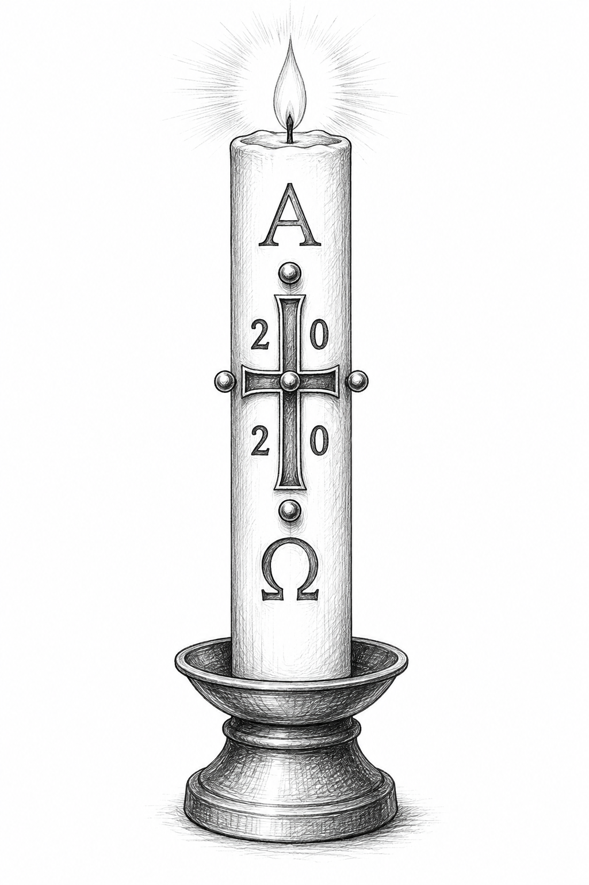
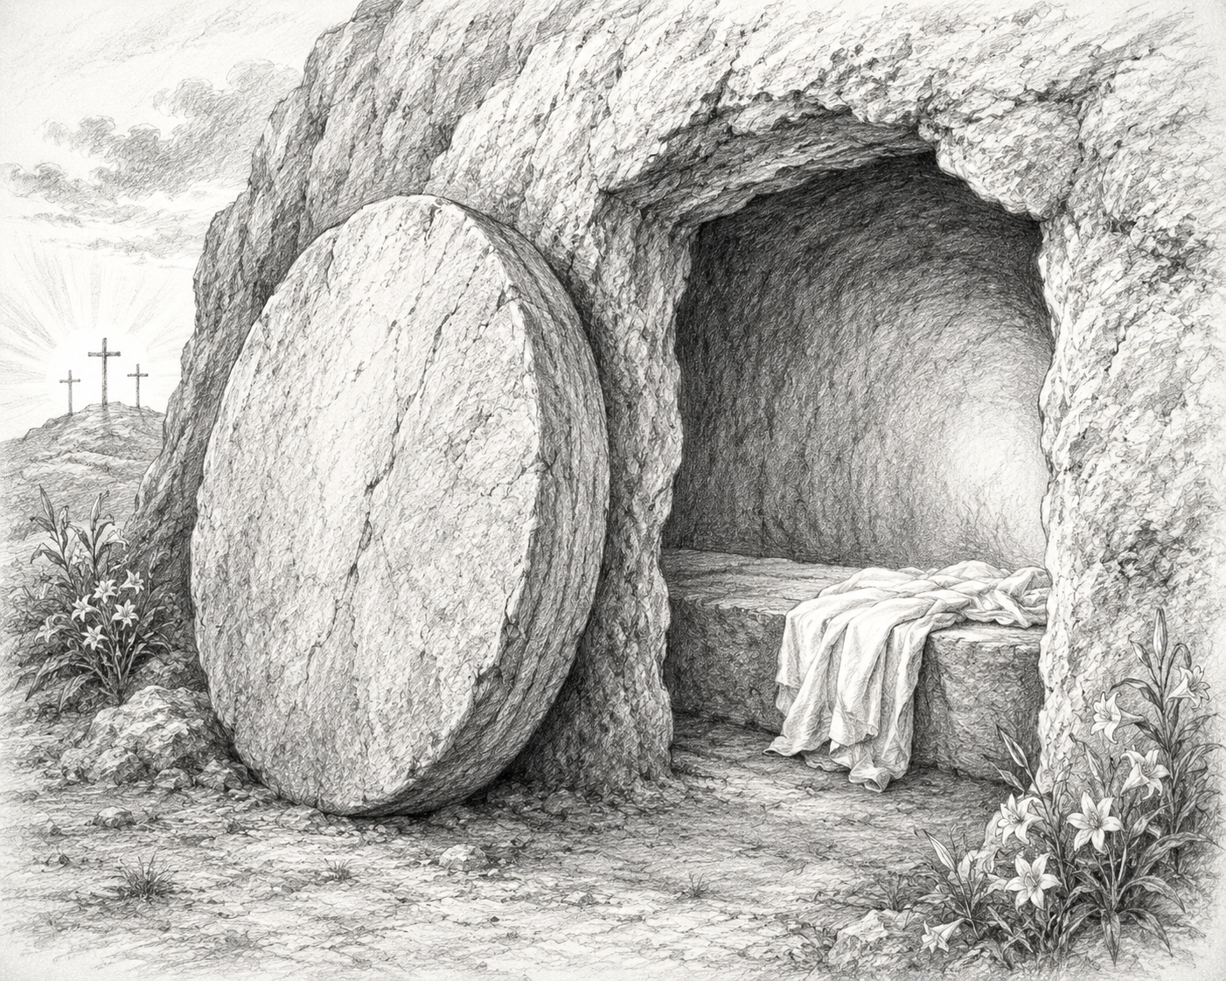
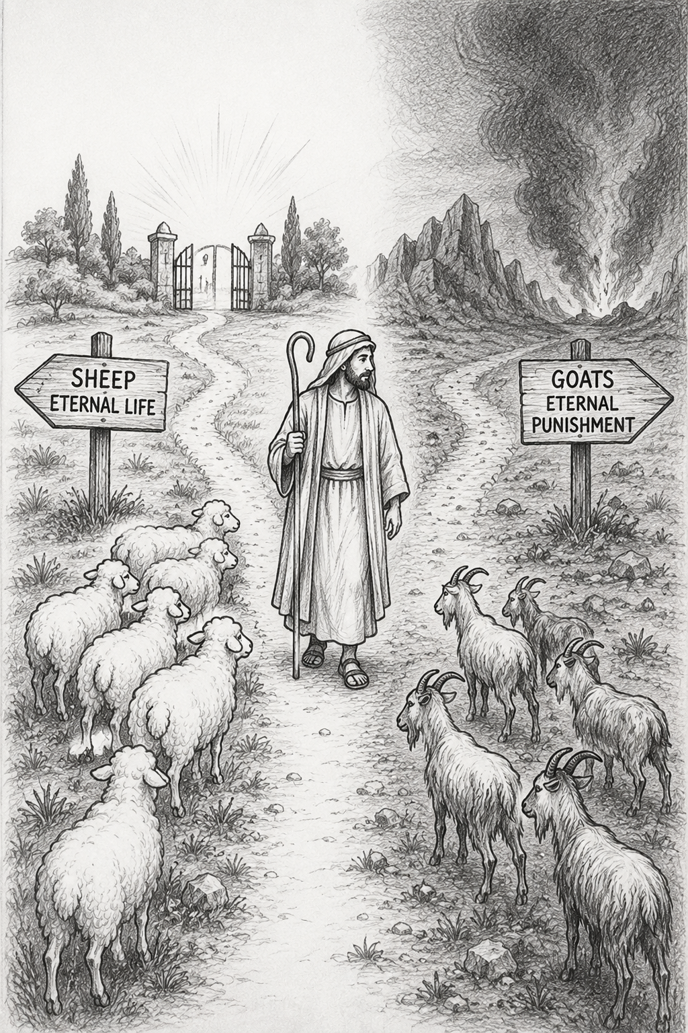
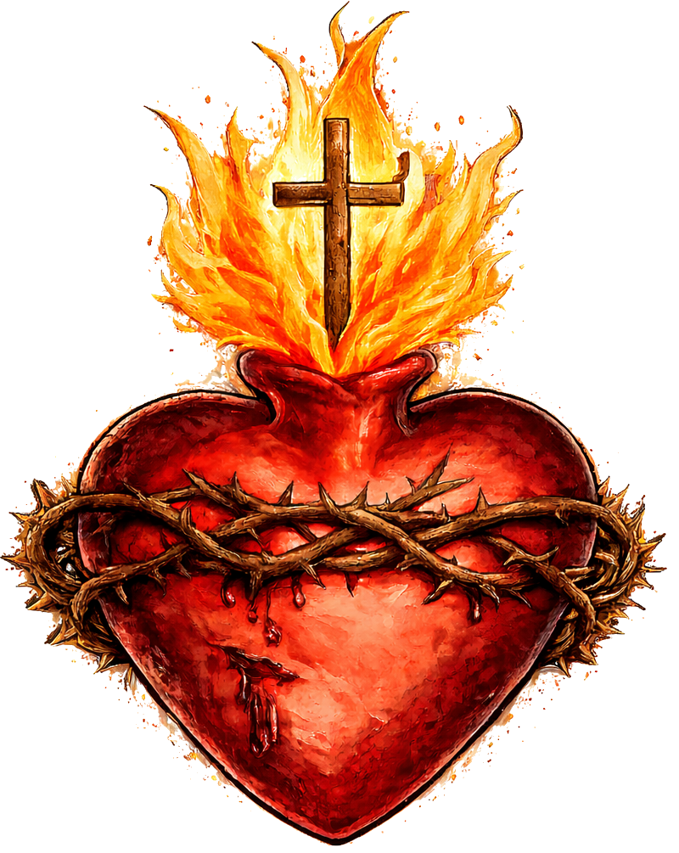
Cognitive Cards:
Life & Death
PhilosophyStudent.co.uk

Slide 2

Component 2.1 Life & Death:
1) Catholic meaning of death and dying well
2) Catholic beliefs about resurrection
3) Eschatology
4) Alternative viewpoints on life after death
5) The debate about the right to die
6) The Magisterium
7) The Second Vatican Council
8) Christian sarcophagi
9) The Paschal candle
10) Music in the liturgy
11) The funeral rite and praying for the dead
12) Prayer
3 Months before exam | Month before exam | Week before exam
* 1 = I know it very well, 2 = I can answer some of the questions, 3 = I need to do more revision

Slide 3
1) Catholic meaning of death and dying well
(b) Describe Catholic teaching about the importance of dying well. [5]
Tracker

Slide 4
P: Catholic: dying well allows people to prepare practically and spiritually for death.
E: - Spend time with family, make a will and plan the funeral
- Receive the Sacrament of the Sick, including absolution (forgiveness of sins) and viaticum (the Eucharist given as “food for the journey”)
E: - Helps the person and their family face death with peace and hope.
- Reduces the burden and stress on the family when arranging the funeral.
- Spiritually prepares the person to meet God.
P: Catholics believe that dying well involves maintaining a person’s dignity and value.
E: Evangelium Vitae (Pope John Paul II) supports palliative care rather than euthanasia.
E: - Palliative care relieves pain while allowing life to continue until natural death.
- Respects the sanctity of life.
- Prepares the soul for judgement and eternal life.

Slide 5
1) Catholic meaning of death and dying well
(b) Describe Catholic teaching on Death. [5]
Tracker

Slide 6
P: Catholics: death is not the end of life.
E: - St Paul: “We will not all sleep, but will be changed” (1 Corinthians 15)
- St Paul: “Where, O death, is your victory? Where, O death, is your sting?” (1 Corinthians 15)
E: - Catholics therefore believe in eternal life with God.
- Death can be faced with hope because Jesus defeated death through his resurrection.
P: Catholics: death leads to judgement and the resurrection of the body.
E: Nicene Creed: teaches that Jesus “will come again to judge the living and the dead”
Catholics “look forward to the resurrection of the dead and the life of the world to come”
E: - Particular judgement: When a person dies their soul goes to heaven, hell or purgatory.
- Final Judgement: the soul will be reunited with a resurrected body
- At death, humans lose their earthly physical body, but Catholics believe they will receive a transformed spiritual body united with their soul

Slide 7
1) Catholic meaning of death and dying well
c) Explain the importance of palliative care for Catholics. [8]
Tracker

Slide 8
P: Palliative care is important because it respects the sanctity of life.
E: - Genesis: “Imago Dei” (We are made in the image of God therefore life is sacred)
- Ten Commandments: “You shall not kill.”
E: - Palliative care is an alternative to euthanasia and assisted suicide.
- It allows a person to live until their natural death.
- Recognises that life is a sacred gift from God and should not be deliberately ended.
P: Palliative care maintains the dying person’s dignity and reduces suffering.
E: Evangelium Vitae teaches that palliative care is appropriate for people approaching death.
E: - Provides pain relief, nursing care and medical support
- Allows patients to refuse treatment that is too burdensome
- Cares for the whole person rather than deliberately ending their life
P: Palliative care follows Jesus’ teaching and example.
E: Jesus taught, “Love your neighbour,” and cared for people who were sick and suffering.
E: - Catholics should show compassion towards the terminally ill.
- Hospices provide practical, emotional and spiritual support.
- Caring for the sick allows Catholics to follow the example of Jesus.
P: Palliative care helps a Catholic to die well.
E: A dying Catholic may receive the Sacrament of the Sick, including absolution (forgiveness of sins)and viaticum (Eucharistic [“Food for the journey”]).
E: - Helps the person face death with peace and hope.
- Supports the family during the person’s final days.
- Prepares the person spiritually for judgement and eternal life.

Slide 9
1) Catholic meaning of death and dying well
(d) ‘It is not possible to die well.’ Discuss. [15]
Tracker

Slide 10
P: Catholics disagree: because people can prepare practically and spiritually for death.
E: - Spend time with family, resolve conflicts, make a will and plan the funeral
- Receive the Sacrament of the Sick, including absolution (forgiveness) and viaticum (the Eucharist given as “food for the journey”)
E: - Reduces anxiety and unfinished business.
- Helps the person face death with peace and hope of heaven.
- Spiritually prepares the person for judgement, as taught by Jesus in the Parable of the Sheep and the Goats, and eternal life
L: Therefore, it is possible to die well because a person can be prepared for death and the hope of eternal life in heaven.
P: Atheists may agree: because they do not believe in life after death.
E: Atheists generally believe that death is the permanent end of a person’s existence.
E: - Religious preparation (Funerals, sacrament of the sick etc. ) may seem meaningless if there is no soul, judgement or eternal life.
- Death ends the only life a person has (No after life so Sacrament of the Sick is pointless).
L: Therefore, an atheist may argue that a person cannot die well because death involves the permanent loss of life.
P: Some Humanists disagree: because they believe dying well involves reducing suffering.
E: Some Humanists support euthanasia or assisted dying to end unbearable suffering.
E: - Humanists often emphasise quality of life rather than the sanctity of life
- They argue that if their pain or disability becomes unmanageable their life may no longer be worth living.
- A person can die well by suffering less.
L: Therefore, Humanists may argue that it is possible to die well if a terminally ill person can choose an end to their suffering through death.
P: Catholics disagree: argue palliative care allows people to die with dignity.
E: Pope John Paul II in Evangelium Vitae supports palliative care rather than euthanasia.
E: - Provides pain relief, nursing care and emotional support
- Allows patients to refuse treatments that are too burdensome
- Respects the sanctity of life by allowing life to continue until natural death
L: Therefore, even someone with a terminal illness may die well if their pain is controlled and their dignity is protected.
In conclusion, the strongest argument is …. Because ….

Slide 11
2) Catholic beliefs about resurrection
(b) Describe Catholic beliefs about the resurrection. [5]
Tracker

Slide 12
Def: Resurrection means the raising of the body to life again after death.
P: Catholics believe Jesus rose bodily from the dead, and this makes resurrection possible for everyone.
E: - All four Gospels describe the empty tomb and appearances of the risen Jesus.
- St Paul: if Christ has not been raised, Christian faith is “futile.”
E: - Jesus’ resurrection shows that he defeated sin and death.
- Catholics therefore believe death is not the end and they can share in eternal life.
P: Catholics believe that humans will experience a resurrection of the body at the end of time in the Final Judgement.
E: - Corinthians: St Paul teaches that the earthly body will be transformed into a “spiritual body.”
- Nicene Creed: Catholics “look forward to the resurrection of the dead and the life of the world to come.”
E: - At death, the soul survives and faces particular judgement.
- At the Final Judgement, the soul will be reunited with a transformed, resurrected body.
- Catholics therefore believe eternal life involves the whole person, body and soul.

Slide 13
2) Catholic beliefs about resurrection
(c) Explain Catholic beliefs about the resurrection of the body. [8]
Tracker

Slide 14
P: Catholics believe in the resurrection of the body because Jesus rose bodily from the dead.
E: - All four Gospels (Matthew, Mark, Luke and John) describe the empty tomb and Jesus’ resurrection.
- The risen Jesus invited Doubting Thomas to touch his wounds, showing that he had a physical body.
E: - Jesus did not rise only as a spirit, but with a body and soul
- This showed the first Christians that bodily resurrection and eternal life are possible.
- Catholics believe Jesus overcame sin and death through his resurrection.
P: Belief in the resurrection is one of the most important Catholic beliefs.
E: St Paul taught: “If Christ has not been raised, your faith is futile” .
E: - If Jesus did not rise, he did not defeat sin and death
- Humanity would remain trapped by sin and death
- Christian faith and hope in Christ and eternal life would be pointless
P: Catholics believe the resurrected body will be a transformed spiritual body united with the immortal soul.
E: -St Paul taught “flesh and blood cannot inherit the kingdom of God” and describes humans receiving a spiritual body
- St Paul's analogy of a grain of wheat: the seed (Earthly body) is buried and becomes a fully grown plant (heavenly Body)
E: - The plant is connected to the original seed, but it has been transformed into a new and greater form
-In the same way, the earthly body dies and decays, but God transforms it into a heavenly spiritual body that never dies
P: Catholics believe that at the Final Judgement, the immortal soul will be reunited with the resurrected body.
E: - The Nicene Creed teaches that Jesus “will come again to judge the living and the dead”
-In the Parable of the Sheep and the Goats, Jesus teaches that people will be judged according to how they treated others.
E: -The dead will be raised at the end of time
- God will judge each person and decide their eternal destiny

Slide 15
2) Catholic beliefs about resurrection
(d) 'The soul lives forever, but there is no resurrection of the body.’ [15]
Tracker

Slide 16
P: Catholics: disagree because Jesus did not return as only a soul but with a bodily resurrection.
E: - Gospels: describe the risen Jesus inviting Doubting Thomas to touch his wounds, showing that he had a real body.
- St Paul taught that Jesus bodily resurrection means Christians should believe in a bodily resurrection.
E: - Jesus’ resurrection overcame sin and death
- It gives Catholics hope in eternal life and their own future resurrection
L: Therefore, Catholics reject the statement because Jesus’ bodily resurrection shows that both the soul and body can live again.
P: Catholics: disagree because they believe the soul will be reunited with a transformed body at the Final Judgement.
E: - St Paul teaches that “flesh and blood cannot inherit the kingdom of God” but describes humans receiving a spiritual body
- Nicene Creed: Catholics “look forward to the resurrection of the dead and the life of the world to come”
E: - At death, the immortal soul is separated from the earthly body.
- God will transform the earthly body into a heavenly body that cannot suffer, decay or die.
- At the end of time, the soul and resurrected body will be reunited.
L: Therefore, Catholics believe that eternal life will be experienced as a complete person consisting of body and soul.
P: Some Reform Jews: agree because they believe in the immortality of the soul but reject a physical resurrection.
E: - There is no clear teaching about bodily resurrection in the Torah
E: - Reform Jews may believe that the soul continues spiritually after death.
- Some believe that people live on through their influence, memories and good deeds
L: Therefore, some Reform Jews agree with the statement because there is little evidence that the physical body will be raised.
P: Orthodox Jews would also disagree because many believe in the resurrection of the dead.
E: -Maimonides: belief in resurrection as one of his Thirteen Principles of Judaism
- References to the resurrection of the dead appear in Orthodox Jewish prayers and funeral beliefs
E: - God will raise the dead as part of Olam Ha-Ba, the World to Come.
- Some Orthodox Jews prefer burial rather than cremation because of their belief in bodily resurrection.
- The soul and body will be reunited when God raises the dead
L: Therefore, Orthodox Jews disagree because the soul survives death and the body will eventually be resurrected.
In Conclusion, the strongest argument is … because

Slide 17
3) Eschatology
(b) Describe the importance of eschatology for Catholics. [5]
Tracker

Slide 18
Def: Eschatology is the study of the four “last things”: death, judgement, heaven and hell.
P: It is important because it gives Catholics hope that death is not the end.
E: - Catechism: Those who die in a state of grace (in friendship with God and free from major sin) are destined for heaven
-St Paul: “O death, where is your sting?”
E: - Catholics believe in eternal life and the resurrection of the body.
- Helps Catholics face death with hope rather than fear.
- Reminds them that the soul can enter heaven, hell or purgatory.
P: Eschatology is important because belief in judgement influences how Catholics live.
E: - Parable of the Sheep and the Goats: people are judged according to how they treated others.
- The Rich Man and Lazarus: the rich man is punished for ignoring the poor in need.
E: - Encourages Catholics to love their neighbour, forgive others and care for the poor.
- Reminds them that their actions have eternal consequences.
- Helps Catholics prepare for judgement.

Slide 19
3) Eschatology
(b) Describe the teachings of Jesus regarding judgement. [5]
Tracker

Slide 20
P: Jesus taught that people will be judged according to whether they showed love and compassion to others.
E: Parable of the Sheep and the Goats: The sheep are welcomed into heaven because they fed the hungry, welcomed strangers, clothed the poor and cared for the sick. The goats are sent away to eternal punishment because they ignored the needs of others.
- Jesus said “Whatever you did for the least of these, you did for me.”
E: - Jesus teaches that caring for others is the same as caring for him.
- Those who show mercy may be rewarded with heaven
- Those who refuse other may face hell (separation from God and goodness)
P: Jesus taught that God judges people according to how forgiving and merciful they are towards others.
E: Parable of the Unmerciful Servant: a master forgives his servant’s large debt, but the servant refuses to forgive another man who owes him money. When the master discovers this, he punishes the servant for showing no mercy.
E: - People cannot expect God’s forgiveness if they refuse to forgive others.
- God’s judgement is based on whether a person shows mercy and forgiveness
- Catholics should show mercy to others like God does to us.

Slide 21
3) Eschatology
(c) Explain Jesus’ teachings about heaven and hell. [8]
Tracker

Slide 22
P: Jesus taught that heaven is a reward for people who show love and compassion to others.
E: Parable of the Sheep and the Goats: the sheep are welcomed into eternal life because they fed the hungry, welcomed strangers, clothed the poor and cared for the sick and imprisoned.
E: - Jesus teaches that caring for others is the same as caring for him
- Heaven is a state of union with God and goodness
- Loving actions can lead to eternal reward
P: Jesus taught that hell is the consequence of ignoring people in need.
E: In the Parable of the Sheep and the Goats, the goats are sent away because they failed to help those who were suffering.
E: - Hell is separation from God and goodness
- People are responsible for what they fail to do, not only for the wrong actions they commit
- Jesus warns that selfishness and lack of compassion have eternal consequences
P: Jesus taught that a person’s destination after judgement is permanent.
E: Parable of the Rich Man and Lazarus: Lazarus (who suffered great poverty) is comforted in heaven, while the rich man suffers in hell after ignoring Lazarus during his life. Nobody can cross the great divide between them.
E: - The rich man cannot change his eternal destination after death.
- People must change their behaviour NOW and follow God’s teachings while alive
P: Jesus taught that entry into heaven depends on showing forgiveness and mercy.
E: Parable of the Unmerciful Servant: the master forgives his servant’s debt, but later punishes him when he refuses to forgive someone else.
E: - People cannot expect God’s forgiveness if they refuse to forgive others
- Those who show mercy will receive mercy at judgement.

Slide 23
3) Eschatology
(d) ‘There is no such thing as Purgatory.’ Discuss. [15]
Tracker

Slide 24
P: Catholics disagree: because some people need to be cleansed from sin before entering heaven.
E: -Catechism: Purgatory refers to the cleansing or purging of a person’s sins before they can enter heaven
- Souls in purgatory “undergo purification”
E: - Sin is a barrier to a relationship with God; purgatory removes what prevents complete union with God in heaven.
- Purgatory is temporary, whereas hell is the permanent rejection of and separation from God
L: Therefore, Catholics reject the statement because purgatory prepares imperfect people for eternal life with God.
P: Many Protestant Christians agree: because purgatory is not clearly mentioned in the Bible.
E: - The word purgatory does not appear in the Bible
- There is no clear biblical description of a temporary state where souls are purified before heaven
E: - Many Protestants believe that Christian teachings must come from Scripture alone
- They reject the authority of Catholic Tradition and the Magisterium, the Pope and bishops
L: Therefore, many Protestant Christians agree with the statement because there is not enough direct biblical evidence that purgatory exists.
P: Catholics disagree because St Paul’s teaching can be interpreted as evidence for purification after death.
E: - St Paul teaches: “The fire will test the quality of each person’s work” in 1 Corinthians 3
- Fire was used in the ancient world to burn and cleanse land so that it could be renewed.
E: - The fire symbolises the cleansing or purging of a person’s mistakes and sins.
- Catholics pray and offer Masses for the dead because they believe their prayers can help souls undergoing purification.
L: Therefore, Catholics believe St Paul’s image of cleansing fire supports the existence of purgatory.
P: Other Christians agree because Jesus’ teachings appear to suggest that people go to either heaven or hell after judgement.
E: - Parable of the Sheep and the Goats: the sheep enter eternal life, while the goats are sent to eternal punishment
- The Rich Man and Lazarus: Lazarus is comforted with Abraham, while the rich man suffers in Hall, with a fixed divide between them.
E: -These teachings describe two destinations rather than a third temporary state.
- People appear to enter either heaven or hell after judgement
L: Therefore, some Christians agree with the statement because Jesus’ teachings suggest that people go directly to either heaven or hell.
In conclusion, the strongest argument is … because …

Slide 25
4) Alternative viewpoints on life after death
(d) ‘There is life after death.’ Discuss. [15]
Tracker

Slide 26
P: Catholics agree: because they believe the immortal soul continues after death and is judged by God.
E: - Nicene Creed: Catholics “look forward to the resurrection of the dead and the life of the world to come”
- Parable of the Sheep and the Goats: those who cared for others enter eternal life
E: - At judgement, the soul may enter heaven, hell or purgatory
- Heaven is eternal union with God, while hell is permanent separation from God
- At the Final Judgement, the soul will be reunited with a transformed, resurrected body
L: Therefore, Catholics agree because the soul survives physical death and receives an eternal destiny from God.
P: Atheists may disagree: because they do not believe in an immortal soul or heaven.
E: - Many atheists accept materialism, the belief that only the physical world exists.
- Thoughts, memories and personality depend upon the physical brain
E: - When the body and brain die, the whole person ceases to exist.
- There is no soul that continues after physical death.
L: Therefore, materialist atheists reject life after death because they believe the physical body is all that exists.
P: Catholics agree because Jesus’ resurrection shows that death is not the end.
E: - St Paul taught: “If Christ has not been raised, your faith is futile”
- The Gospels describe the empty tomb and Jesus appearing to his followers after his death
E: - Jesus’ resurrection gives Catholics hope that they will also be raised
- It offers hope of eternal life with God in heaven
L: Therefore, Catholics agree that there is life after death because Jesus’ resurrection shows the path to freedom from sin and death.
P: Hindus & Sikhs agree because they believe the soul is reincarnated into another body after death.
E: Hindus believe in samsara, the cycle of life, death and rebirth
A person’s karma affects the body and circumstances into which they are reborn
E: - The physical body dies, but the eternal soul continues into a new life
- Good karma can lead to a more favourable rebirth, while bad karma can lead to a less favourable one
L: Therefore, Hindus agree that there is life after death because the atman continues through reincarnation.

Slide 27
5) The debate about the right to die
(b) Describe Catholic teaching regarding euthanasia. [5]
Tracker

Slide 28
Def: Euthanasia is the deliberate ending of a person’s life, usually to end suffering from a serious or terminal illness.
P: Catholics believe euthanasia is always morally wrong because human life is sacred.
E: - Genesis: humans are made “in the image of God”.
- Ten Commandments: “You shall not murder.”
- Evangelium Vitae: Pope St John Paul II calls euthanasia a “grave violation of the law of God.”
E: - Life is a gift from God, so humans do not have the right deliberately to end innocent life.
- Catholics believe life should be protected from conception until natural death.
P: Catholics believe suffering should be treated through palliative care rather than euthanasia.
E: Evangelium Vitae supports pain relief and allows patients to refuse extraordinary or excessively burdensome treatment.
E: - Palliative care can relieve pain and maintain dignity while allowing natural death.
- Giving strong painkillers is acceptable even if they unintentionally shorten life, provided the intention is to relieve suffering, not cause death.
- Therefore, Catholics distinguish allowing natural death from deliberately causing death through euthanasia.

Slide 29
5) The debate about the right to die
(C) Explain why the Catholic Church says euthanasia is wrong. [8]
Tracker

Slide 30
P: The Catholic Church says euthanasia is wrong because it goes against the sanctity of life.
E: Genesis: humans are created “in the image of God” (Imago Dei).
E: - Every human life has God-given dignity and value, even when someone is seriously ill or dying.
- Life is a gift from God and should be protected until natural death.
- Illness or disability does not make a person's life less valuable.
P: Euthanasia is wrong because Catholics believe humans do not have the right to deliberately take innocent life.
E: - Ten Commandments: “You shall not murder.”
- Evangelium Vitae: euthanasia is a “grave violation of the law of God.”
E: - God is the giver of life, so humans should not deliberately decide when an innocent person's life ends.
- Euthanasia directly intends death rather than allowing a person to die naturally.
P: The Church says euthanasia is wrong because there is a more compassionate alternative: palliative care.
E: Evangelium Vitae supports palliative care to make suffering more bearable at the end of life.
E: - Hospices can provide pain relief, nursing care and emotional/spiritual support.
- Strong painkillers may be used even if they shorten life, because the intention is to relieve pain, not cause death.
- This allows a person to maintain their dignity while dying naturally.
P: Euthanasia is wrong because Catholics believe the sick and vulnerable deserve greater care and protection, not death.
E: - Canada MAID program: Cases where people with poor mental health or back pain are able to end their lives.
- Protecting vulnerable people reflects Jesus' command to “love your neighbour.”
E: Legal euthanasia could make some elderly, disabled or seriously ill people feel they are a burden.
Catholics believe compassion means caring for and accompanying someone who is suffering.

Slide 31
5) The debate about the right to die
(d) ‘Euthanasia is always wrong.’ [15]
Tracker

Slide 32
Def: Euthanasia is the deliberate ending of a person’s life, usually to end suffering from a serious or terminal illness.
P: Catholics agree: euthanasia is always wrong because it goes against the sanctity of life.
E: - Genesis: humans are created “in the image of God” (Imago Dei).
- Ten Commandments: “You shall not murder.”
- Evangelium Vitae: euthanasia is a “grave violation of the law of God.”
E: - Every human life has God-given dignity and value, even when someone is suffering.
- Life is a gift from God, so humans should not deliberately decide when innocent life ends.
- Catholics believe life should be protected until natural death.
L: Therefore, Catholics agree euthanasia is always wrong because deliberately ending life rejects its sacred value.
P: Many Humanists disagree: euthanasia may be acceptable when a person has an extremely poor quality of life and freely chooses to die.
E: - Humanists emphasise the right of individuals to make decisions about their own lives.
- The British Humanist Association supported Tony Nicklinson, who had locked-in syndrome and wanted the legal right to an assisted death.
E: - A person experiencing unbearable suffering may believe continued life is no longer acceptable for them.
- Allowing a competent adult to choose may preserve their dignity and control.
L: Therefore, euthanasia may not always be wrong if it is a free and informed choice made to end unbearable suffering.
P: Catholics agree: euthanasia is unnecessary because palliative care can relieve suffering without deliberately causing death.
E: Evangelium Vitae supports palliative care as a way to make suffering more bearable at the end of life.
E: - Hospices provide pain relief, nursing care and emotional/spiritual support.
- Strong painkillers may be used even if they unintentionally shorten life, because the intention is to relieve pain rather than cause death.
- This allows the person to maintain dignity while dying naturally.
L: Therefore, Catholics argue euthanasia is always wrong because there is a more compassionate alternative that cares for the person without killing them.
P: Some Liberal Christians disagree: in extreme circumstances, euthanasia could be the most loving and compassionate response.
E: - Jesus taught: “Love your neighbour as yourself.”
E: - Jesus consistently showed compassion towards people who were sick and suffering.
- If a terminally ill person is experiencing unbearable suffering, some Christians may believe helping them die could be an act of mercy rather than cruelty.
L: Therefore, some Christians disagree because compassion may be more important than prolonging suffering.
In conclusion, the strongest argument is …. Because …

Slide 33
6) The Magisterium
(b) Describe the different types of Magisterium. [5]
Tracker

Slide 34
Def: The Magisterium is the teaching authority of the Catholic Church, exercised by the Pope and bishops.
P: One type is the Ordinary Magisterium: the normal teaching of the Church.
E: - Bishops teach through homilies and letters to their dioceses.
- Popes may write encyclicals, such as Evangelium Vitae or Laudato Si.
E: - It explains and reinforces existing Catholic teaching.
- It helps Catholics understand how Church teaching applies to modern issues.
P: The other type is the Extraordinary Magisterium, which has two forms: Conciliar and Pontifical.
E: - Conciliar Magisterium: the Pope and bishops meet in a General Council, e.g. the Second Vatican Council.
- Pontifical Magisterium: the Pope makes a rare ex cathedra declaration; this is considered infallible (without error).
E: - Conciliar teaching settles important issues for the whole Church.
- Pontifical teaching gives the Pope’s final authoritative decision on a matter of faith or morality.

Slide 35
6) The Magisterium
(c) Explain the importance of the Magisterium to the Catholic Church. [8]
Tracker

Slide 36
P: The Magisterium is important because it helps the Church respond to new moral and social issues.
E: - Ordinary Magisterium, such as papal encyclicals (letters from the Pope), gives guidance on modern issues.
- Evangelium Vitae: applies Catholic teaching to euthanasia and the sanctity of life.
- Laudato Si’: applies Catholic teaching to environmental issues such as pollution and climate change.
E: - Gives Catholics practical guidance about how to live their faith today.
- Helps apply Jesus’ teaching to modern situations not directly mentioned in the Bible.
P: The Magisterium is important because it allows Catholics to interpret the Bible correctly.
E: - Catechism: interpretation of the Word of God (Bible) is entrusted to the Pope and bishops.
- The early Church established the canon of Scripture (Put together the books in the Bible).
E: - Scripture can sometimes be difficult to understand or interpreted in different ways.
- The Magisterium explains how Catholics should understand and apply biblical teaching.
P: The Magisterium is important because Jesus gave authority to his Apostles to lead and teach the Church.
E: - Jesus called Peter the “rock” on which he would build his Church.
- The Pope is the successor of St Peter, while bishops continue the work of the Apostles through apostolic succession.
- The Extraordinary Pontifical Magisterium allows the Pope to make an ex cathedra teaching on faith or morality.
E: - Gives the Pope and bishops authority to teach in Jesus’ name.
- Means Catholic teaching today has a direct connection back to Christ and the Apostles.
P: The Magisterium is important because Catholics believe it is guided by the Holy Spirit.
E: John’s Gospel: Jesus describes the Holy Spirit as the “Spirit of truth.”
E: - Catholics believe the Holy Spirit helps the Church teach faithfully and avoid error.
- This gives the Magisterium religious authority, not simply human authority.

Slide 37
6) The Magisterium
(d) ‘Catholics do not need the Magisterium to guide them in their faith.’ Discuss. [15]
Tracker

Slide 38
P: Catholics disagree: because the Magisterium helps them apply Christian teaching to modern moral and social issues.
E: - The Ordinary Magisterium gives guidance through papal encyclicals.
- Evangelium Vitae applies Catholic teaching to euthanasia and the sanctity of life.
- Laudato Si’ applies Catholic teaching to environmental issues such as pollution and climate change.
E: - The Bible may not directly mention many modern issues.
- Magisterium to explain how Jesus’ teachings apply today.
- This gives Catholics clear guidance when making difficult moral decisions.
L: Therefore, Catholics do need the Magisterium because it makes ancient Christian teaching relevant to modern life.
P: Some may agree because Catholics can be guided directly by the Bible and Jesus’ teachings.
E: - Dei Verbum encouraged Catholics to engage more closely with Scripture.
- Jesus gives clear teachings such as “Love your neighbour” and the Golden Rule.
E: - Catholics can read the Gospels and use Jesus’ example when deciding how to behave.
- Many moral teachings, such as forgiving others, helping the poor and rejecting murder, are already clear in Scripture.
L: Therefore, Catholics may not always need the Magisterium because Scripture itself can provide moral guidance.
P: Catholics would disagree because Jesus gave the Apostles authority to lead and teach the Church.
E: - Jesus called Peter the “rock” on which he would build his Church.
- The Pope is the successor of St Peter, while bishops continue the work of the Apostles through apostolic succession.
- John’s Gospel: the Holy Spirit is the “Spirit of truth.”
E: - Catholics believe the Pope and bishops teach with authority that ultimately comes from Christ.
- The Holy Spirit guides the Church in interpreting Scripture and Tradition.
- Rejecting the Magisterium could therefore mean rejecting an authority that Catholics believe Jesus established.
L: Therefore, Catholics need the Magisterium because it continues the teaching authority of Christ and the Apostles.
P: Some may agree because individual Catholics also have a responsibility to use their conscience, prayer and personal faith.
E: - Lumen Gentium teaches that the laity have an important role in the life and mission of the Church.
- Catholics can pray, read Scripture and reflect on Jesus’ example themselves.
E: - Catholics must make moral choices in their own lives and take personal responsibility for them.
L: Therefore, Catholics may not always need direct guidance from the Magisterium because faith also involves personal responsibility and conscience.
In conclusion, the strongest argument is …. Because …

Slide 39
7) The Second Vatican Council
(b) Describe two of the key documents of the Second Vatican Council. [5]
Tracker

Slide 40
Def: The Second Vatican Council (Vatican II) was a meeting of the Pope and bishops in the 60’s which considered how the Catholic Church should respond to the modern world.
P: One key document was Sacrosanctum Concilium, which focused on the liturgy and worship of the Church.
E: - It encouraged greater participation of the laity in Mass.
- Mass could be celebrated in the local language rather than only Latin.
- The priest usually faced the congregation and a wider range of Bible readings was introduced.
E: - This helped Catholics understand and participate more fully in worship.
- It made the Mass more accessible to ordinary Catholics and understand more of the bible.
P: Another key document was Dei Verbum, meaning “Word of God,” which focused on Scripture and Tradition.
E: - It taught that Catholics know God through both the Bible and the Tradition of the Church.
- It encouraged Catholics to read and study the Bible more regularly.
- It taught that the Bible should be interpreted carefully, taking account of its different literary forms.
E: - This increased the importance of Scripture in Catholic worship, prayer and teaching.
- It also reinforced the role of the Magisterium in interpreting the Bible correctly.

Slide 41
7) The Second Vatican Council
(c) Explain the importance of the Second Vatican Council. [8]
Tracker

Slide 42
P: Vatican II was important because it helped the Catholic Church respond to the modern world.
E: - Gaudium et Spes encouraged Catholics to respond to issues such as poverty, injustice and war and to promote peace.
- It led to the founding of groups such as CAFOD & Pax Christi.
E: - Helped the Church become more involved with the problems facing ordinary people.
- Encouraged Catholics to put their faith into action through social justice and service to others just as Christ thought in the parable of the Sheep and Goats.
P: Vatican II was important because it made the Mass easier for ordinary Catholics to understand and participate in.
E: - Sacrosanctum Concilium allowed Mass to be celebrated in the local language rather than only Latin.
- The priest usually faced the congregation and the range of Bible readings was increased.
E: - Catholics could understand the words and symbols of the Mass more clearly.
- The laity became active participants rather than simply spectators.
- This helped Catholics become more involved in worship and parish life.
P: Vatican II was important because it increased the importance of the Bible in Catholic life.
E: - Dei Verbum encouraged Catholics to read, study and pray with Scripture.
- It taught that different literary forms in the Bible should be considered when interpreting it.
E: - This led to greater Bible study in parishes and Catholic education.
- It helped Catholics develop a deeper understanding of Jesus and their faith.
P: Vatican II was important because it emphasised that all Catholics have a role in the mission of the Church.
E: - Lumen Gentium taught that the Church is like a body, with both clergy and laity having important roles. The eyes role as as important as the hands or heart.
- It encouraged Catholics to serve others and bring the “light of Christ” into the world.
E: - The laity became more involved in the Mass and parish life (Alter servers & Eucharistic ministers).
- It encouraged Catholics to take greater responsibility for serving others and spreading the faith.
- The mission of the Church belongs to all Catholics, not just priests and bishops.

Slide 43
7) The Second Vatican Council
(d) ‘The changes brought about by the Second Vatican Council were needed.’ Discuss. [15]
Tracker

Slide 44
P: Catholics agree: because it help ordinary Catholics understand and participate in worship.
E: - Before Vatican II, much of the Mass was celebrated in Latin, which many Catholics did not understand.
- Sacrosanctum Concilium allowed greater use of the local language, and the priest usually faced the congregation.
E: - Catholics could better understand the prayers, readings and symbols of the Mass.
- The laity became active participants rather than simply spectators.
- Worship could therefore have a greater impact on Catholics’ faith and daily lives.
L: Therefore, the changes were needed because the Mass became more accessible and understandable for ordinary Catholics.
P: Some Catholics might disagree because the traditional Latin Mass united Catholics throughout the world.
E: Before Vatican II, Catholics in different countries worshipped using the same Latin language.
- For example, an English Catholic attending Mass abroad would still recognise the same prayers and responses.
E: - Latin emphasised the universal nature of the Catholic Church.
- Catholic in England in 1950s experiences the same mass as St Francis in Italy in the 1200s
L: Therefore, some changes may not have been needed because the traditional Mass already helped create a shared worldwide Catholic identity.
P: Catholics may agree because Vatican II was needed to help the Church respond to the problems of the modern world.
E: - After the Second World War, society, technology and politics had changed considerably.
- Gaudium et Spes encouraged Catholics to respond to poverty, injustice and war and work for peace.
- Its lead to organisations such as CAFOD and Pax Christi being set up.
E: - The Church became more involved with the problems facing ordinary people.
- Catholics were encouraged to put Jesus’ teaching into action through social justice and service, as in the Parable of the Sheep and Goats.
- This made the Church more relevant to the needs of the twentieth-century world.
L: Therefore, these changes were needed because the Church had to engage with a rapidly changing society rather than remain separate from it.
P: Some Catholics might disagree because the Church should preserve unchanging Christian truth rather than change to fit the modern world.
E: - Catholics believe the Church was founded by Jesus, and its teachings come from Scripture and Tradition.
- Some argue there was no need to change because we can follow Jesus teaching from Scripture and Tradition
E: - Society and popular opinions continually change, but Catholic beliefs should not simply change with them.
- The Church’s purpose is to guide the world towards Christ.
L: Therefore, some Catholics may argue that not all change was needed because the Church should remain faithful to its traditional beliefs and identity.
In conclusion, the strongest argument is …. Because …

Slide 45
8) Christian sarcophagi
b) Describe two features of the Sarcophagus with Scenes of the Passion in Rome. [5]
Tracker

Slide 46
Def: A sarcophagus is a decorated stone coffin. The Sarcophagus with Scenes of the Passion uses carvings from Jesus’ suffering, death and resurrection.
P: One feature is the Chi-Rho surrounded by a laurel wreath in the centre.
E: - The Chi-Rho (XP) uses the first two Greek letters of Christ.
- The laurel wreath was a Roman symbol of victory.
- Beneath it is an empty cross.
E: - Together these images show Christ’s victory over death through the resurrection.
P: Another feature shows Jesus being crowned.
E: - The Gospels describe Jesus receiving a crown of thorns, the sarcophagus shows him receiving a jewelled crown.
E: - This changes an image of humiliation into one of victory and kingship.
- It shows that although Jesus suffered and died, Christians believe he is the true King who defeated death.

Slide 47
8) Christian sarcophagi
(c) Explain why the Sarcophagus with Scenes of the Passion in Rome is important. [8]
Tracker

Slide 48
P: The sarcophagus is important because it expresses the Christian belief that Jesus defeated death through the resurrection.
E: - The Chi-Rho represents Christ and is surrounded by a laurel wreath, a Roman symbol of victory.
- Beneath it is an empty cross.
E: - These images show that Jesus’ death was not the end.
- His resurrection brought victory over sin and death.
- This gives Christians hope in their own resurrection and eternal life.
P: The sarcophagus is important because it helps Christians understand Christ’s sacrificial love for humanity.
E: - It shows scenes from Jesus’ Passion, including carrying the cross, being crowned and appearing before Pilate.
E: - Reminds Christians that Jesus willingly suffered and died for humanity.
- Encourages Christians to respond with love for others, even those who persecute us.
P: The sarcophagus is important because it shows that Jesus is the true King and Messiah.
E: - The Gospels describe Jesus receiving a crown of thorns, but the sarcophagus shows him receiving a jewelled crown.
E: - The jewelled crown changes an image of humiliation into kingship and triumph.
- It shows that although Jesus was mocked as a king, Christians believe he is the true King and Christ.
P: The sarcophagus is important because it gave comfort and hope to Christians mourning the dead.
E: - Early Christian sarcophagi were placed in catacombs and decorated with images showing the faith of the person who had died.
- The carvings focused on Jesus’ Passion and resurrection.
E: - Reminded grieving families that death is not the end.
- Gave hope that the dead person would share in Christ’s eternal life.
- Also showed the deceased person’s Christian identity and faith.

Slide 49
9) The Paschal candle
(b) Describe what two of the symbols on a Paschal candle represent. [5]
Tracker

Slide 50
Def: The Paschal candle is a large candle first lit at Easter. It symbolises Jesus’ resurrection and victory over death.
P: The Alpha and Omega (Α and Ω) represent that Christ is the beginning and the end of all things.
E: - Alpha is the first letter of the Greek alphabet and Omega is the last.
- They show that Jesus existed before creation, is present now and will remain forever.
E: - Reminds Catholics that Christ is eternal.
- Shows that Jesus has power over life, death and all of history.
P: The five studs represent the five wounds Jesus received at the Crucifixion.
E: - They represent the wounds in Jesus’ hands, feet and side.
- The studs traditionally contain incense, reminding Catholics of the spices used at Jesus’ burial.
E: - Reminds Catholics of Jesus’ suffering and sacrificial death.
- The wounds remaining on the risen Christ show that the same Jesus who was crucified rose from the dead.
- This links the candle directly to the Paschal Mystery — Jesus’ death and resurrection.

Slide 51
9) The Paschal candle
(c) Explain why the Paschal candle is used in the Easter Vigil and during a Catholic baptism. [8]
Tracker

Slide 52
P: The Paschal candle is used at the Easter Vigil because it represents Jesus’ resurrection overcoming sin and death.
E: - The church begins in darkness and the Paschal candle is lit from a new fire.
E: - The darkness represents sin and death, while the candle represents the risen Christ.
- It reminds Catholics that Jesus’ resurrection brought hope, salvation and eternal life.
P: The Paschal candle is used at the Easter Vigil because Christ’s light is shared with the whole Church.
E: - The priest carries the candle into the dark church and proclaims “The light of Christ.”
- Members of the congregation light their own candles from the Paschal candle.
E: - The church gradually fills with light, symbolising Christ’s light spreading through the world.
- It reminds Catholics that they should share the Good News and live in the light of Christ.
P: The Paschal candle is used during Baptism because Baptism gives a person new life in Christ.
E: - A smaller baptismal candle is lit directly from the Paschal candle.
- It symbolises receiving the light of Christ.
- The Paschal candle represents the risen Jesus and the new life made possible through his resurrection.
E: - Baptism joins the person to Christ’s death and resurrection.
- It shows that the baptised person begins a new life as a Christian.
P: The Paschal candle is important because the year written on it shows that Christ’s resurrection is still relevant today.
E: - Each new Paschal candle has the current year marked on it at the Easter Vigil.
- This reminds Catholics that Jesus is present now, as he was in the past and will be in the future.
E: - The resurrection is not just an event from the first Easter; it continues to give Christians hope of salvation and eternal life today.

Slide 53
10) Music in the liturgy
(b) Describe two parts of the Mass that are often sung. [5]
Tracker

Slide 54
P: One part of the Mass that is often sung is the Gospel Acclamation.
E: - The congregation usually sings “Alleluia” before the Gospel is read.
E: - This welcomes the words and teaching of Jesus in the Gospel.
- Singing it expresses praise and joy.
- It prepares Catholics to listen carefully to Christ’s teaching.
P: Another part often sung is the responses during the Eucharistic Prayer.
E: - These include the the Mystery of Faith and the Great Amen.
- The Mystery of Faith: “We proclaim your Death… and profess your Resurrection.”
E: - These responses allow the congregation to join actively in the Mass.
- They express shared Catholic beliefs about Jesus’ death, resurrection and salvation.
- The Great Amen shows that the congregation agrees with and accepts the Eucharistic Prayer.

Slide 55
10) Music in the liturgy
(c) Explain the important of music in the Mass. [8]
Tracker

Slide 56
P: Music is important because it helps Catholics pray and worship God more deeply.
E: - St Augustine: “Those who sing pray twice.”
- Catholics sing prayers such as the Gloria and the Sanctus (“Holy, Holy, Holy”).
E: - Singing can help Catholics express praise, joy and thanksgiving more strongly than spoken words alone.
- It helps worshippers focus their minds and hearts on God.
P: Music is important because it unites the congregation in worship.
E: - A Starting hymn is often sung as the congregation comes together at the beginning of Mass.
E: - Singing together expresses a shared Catholic faith.
- It helps the congregation participate rather than simply watching the priest.
P: Music is important because it helps Catholics remember and understand their beliefs.
E: - During the Mystery of Faith, Catholics may sing: “We proclaim your Death… and profess your Resurrection.”
E: - Important beliefs about Jesus’ death, resurrection and salvation are repeated through music.
- This makes Catholic beliefs easier to learn and remember.
P: Music is important because it can help Catholics feel closer to God and experience the sacredness of the Mass.
E: - The Psalm is often sung during the Liturgy of the Word, turning Scripture into prayer.
- Gregorian chant developed from monks and nuns singing the Psalms and is still used today.
E: - Sacred music makes Mass feel different from ordinary everyday life.
- It can create a sense of awe, peace and closeness to God.
- This can help Catholics reflect more deeply on heavenly things.

Slide 57
10) Music in the liturgy
(c) Explain how Faure's Requiem reflects Catholic ideas about life after death. [8]
Tracker

Slide 58
Def: A Requiem is music written for a funeral; the word comes from the Latin for “rest.”
P: Fauré’s Requiem reflects the Catholic belief that after death people can experience eternal rest with God.
E: - Fauré said his Requiem was dominated by “faith in eternal rest.”
E: - Catholics believe death is not the end of existence.
- They hope that the deceased will leave behind the suffering of earthly life and experience eternal peace with God.
P: Fauré’s Requiem reflects the Catholic belief that Christians should face death with hope rather than fear.
E: - Fauré song is gentle music and has been described as a “lullaby of death.”
E: - The calm music presents death as a hopeful rather than something terrifying.
- This reflects St Paul’s confidence: “Where, O death, is your sting?”
- Catholics believe Jesus’ resurrection means death has been defeated.
P: Fauré’s Requiem reflects Catholic belief in heaven and paradise.
E: - Fauré uses harps, violins and high angelic soprano voices.
E: - The heavenly sound represents the hope that the deceased has entered God’s presence.
- It reflects the Catholic belief that heaven is a place/state of peace, happiness and union with God.
P: Fauré’s Requiem reflects the Catholic belief that Christians should pray for the dead.
E: Fauré’s wrote it as a prayers asking God for mercy and eternal life for those who have died.
E: - Catholics pray that God will welcome the deceased into heaven.
- This also reflects belief that souls may need God’s mercy and purification before entering his presence.
- The music therefore gives mourners comfort and hope for the person who has died.

Slide 59
10) Music in the liturgy
(d) ‘Churches should replace old hymns with more modern music.’ Discuss. [15]
Tracker

Slide 60
P: Some Christians would agree because modern music may help attract and engage younger people.
E: - Churches such as Hillsong use modern worship music and have attracted many younger worshippers.
- Modern hymns such as “Shine Jesus Shine” can be upbeat and encourage active participation.
E: - Music that sounds familiar to younger generations may make church feel more accessible and welcoming.
- This could help the Church fulfil its mission to spread the Gospel to new generations.
- If people participate more enthusiastically, music can help them pray and connect with God.
L: Therefore, churches may benefit from replacing some older hymns with music that engages people today.
P: Other Christians would disagree because old hymns connect Christians with the history and tradition of their faith.
E: - The Psalms are ancient prayers and hymns that were used by Jesus and the first Christians.
- Monks and nuns later developed traditions such as Gregorian chant, which is still sung today.
E: - Singing older music connects worshippers with generations of Christians before them.
- Something does not lose its value simply because it is old.
L: Therefore, old hymns should not be replaced because they connect Catholics to the long tradition of the Church.
P: Some Christians would agree because modern hymns can make worship easier to understand and participate in.
E: - Modern hymns often use contemporary language, which may be easier for worshippers to understand.
- They can also reflect different cultures and musical traditions, making worship more inclusive.
E: - People are more likely to sing confidently if they understand the words and style of music.
- This follows the spirit of Vatican II, which encouraged greater participation of the laity in worship.
- The purpose of church music is to help people pray, not simply to preserve an old style.
L: Therefore, modern music may be better when it helps more people understand and actively participate in worship.
P: Other Christians would disagree because traditional music can make worship feel more sacred and focused on God.
E: - Traditional Latin hymns and Gregorian chant sound very different from ordinary popular music.
- The Church teaches that the beauty of sacred music can raise a person’s mind towards “heavenly things.”
E: - A distinctive style reminds worshippers that Mass is sacred and different from everyday life.
- Many traditional hymns have survived for generations because their words and melodies are beautiful and meaningful.
- Replacing them with music similar to everyday popular culture could weaken the sense of awe and reverence in worship.
L: Therefore, churches should preserve traditional hymns because they can help worshippers experience the beauty and holiness of God.
In conclusion, the strongest argument is …. Because …

Slide 61
11) The funeral rite and praying for the dead
(b) Describe two features of a Catholic funeral rite. [5]
Tracker

Slide 62
P: One feature is that the coffin is covered with a white pall and sprinkled with holy water.
E: - The white pall reminds Catholics of the white garment given at Baptism and shows that everyone is equal before God.
- The coffin is sprinkled with holy water to recall the person’s Baptism.
E: This reminds mourners that Baptism washes away sin and gives hope of eternal life with Christ.
P: Another feature is the use of the Paschal candle beside the coffin.
E: - The Paschal candle is the Easter candle and symbolises Jesus’ resurrection and victory over death.
- It is placed near the coffin during the funeral.
E: - Reminds mourners that Christians believe death is not the end.
- Gives hope that the deceased may share in Christ’s resurrection and eternal life.

Slide 63
11) The funeral rite and praying for the dead
(c) Explain four features of a Catholic funeral rite. [8]
Tracker

Slide 64
P: One feature is the use of the white pall and holy water.
E: - The coffin is covered with a white pall, recalling the white garment given at Baptism.
- It is also sprinkled with holy water.
E: - This reminds Catholics that the deceased was washed free from sin in Baptism and became part of the Church.
- It also shows that all people are equal before God and gives hope of eternal life.
P: Another feature is the Paschal candle beside the coffin.
E: - The Paschal candle represents Jesus’ resurrection and victory over death.
- It is the same candle used at Easter
E: - Reminds mourners that Christians believe death is not the end.
- Gives hope that the deceased may share in Christ’s resurrection and eternal life.
P: Another feature is the use of Bible readings and the priest’s homily.
E: - Readings are chosen which focus on resurrection and eternal life, for example Revelation: “There will be no more death.”
- The priest explains in the homily that Christ defeated death through his resurrection.
E: - This gives the grieving family comfort and hope.
- It reminds them that Catholic belief is that the deceased can have eternal life with God.
P: A final feature is the Final Commendation, when the Church says goodbye to the deceased.
E: - The prayer says: “May the angels lead you into paradise.”
- It asks that the deceased be welcomed by the saints into the “new and eternal Jerusalem.”
E: - Expresses Catholic belief in heaven and life after death.
- It allows mourners to entrust the person to God’s care and say their final goodbye with hope rather than despair.

Slide 65
11) The funeral rite and praying for the dead
(d) ‘There is no need to pray for the dead in a religouse funeral.’ Discuss. [15]
Tracker

Slide 66
P: Catholics would disagree because prayers may help souls who are being purified in Purgatory.
E: - Catechism: Purgatory refers to the cleansing or purging of a person’s sins before they can enter heaven
- Souls in purgatory “undergo purification”
E: - Catholics believe those destined for heaven may first need purification from sin.
- Prayers are intercessions asking God to show mercy and welcome the deceased into heaven.
- Therefore, praying for the dead may spiritually benefit the person who has died.
L: Therefore, Catholics believe there is a need to pray for the dead because prayer may help them towards Heaven.
P: Many Protestant Christians would agree because they reject the Catholic belief in Purgatory.
E: - Purgatory is not clearly mentioned in the Bible.
- In the Parable of the Sheep and Goats, people are judged according to how they lived and enter either Heaven or Hell.
E: - Prayer at a funeral cannot change the life they lived.
- It cannot change whether they accepted or rejected God before death.
- Therefore, praying for someone to leave Purgatory would be pointless if Purgatory does not exist.
L: Therefore, some Christians agree because a person’s eternal destination depends on God’s judgement of their life, not prayers said afterwards.
P: Catholics would disagree because praying for the dead is an important way of showing love, respect and remembrance.
E: - Catholics pray: “Eternal rest grant unto them, O Lord.”
- Maccabees: it is a “holy and wholesome thought to pray for the dead.”
E: - Prayer shows that the deceased is still loved and remembered by the Christian community.
- It can give grieving relatives comfort and hope that their loved one is with God.
- It unites the living and the dead as members of the Church.
L: Therefore, even apart from Purgatory, prayer has value because it helps Christians express love, hope and faith in eternal life.
P: Atheists and Humanists may agree because they do not believe prayer can affect someone who has died.
E: - Many believe that when the brain and body die, personal existence ends.
- They do not believe in an immortal soul.
E: - A funeral can still remember the person through memories, music and stories about their life.
- Therefore, prayer would not benefit the deceased if there is nothing after death.
L: Therefore, non-religious people may agree that prayer for the dead is unnecessary, even though the funeral itself can still have value for those grieving.
In conclusion, the strongest argument is …. Because …

Slide 67
12) Prayer
(b) Describe two different types of prayer used in Catholic worship. [5]
Tracker

Slide 68
Def: Prayer is described by the Catechism as the “raising of the mind and heart to God.”
P: One type of prayer is Adoration: worshipping and praising God simply because God is worthy of worship.
E: - Catholics may pray silently before the Blessed Sacrament, believing Christ is present in the Eucharist.
- The Gloria and “Holy, Holy, Holy” are also prayers of adoration.
E: - Catholics recognise God’s greatness and holiness.
- It helps them focus completely on God rather than asking for something for themselves.
P: Another type is Thanksgiving: thanking God for what he has done and provided.
E: - Catholics may thank God for creation, answered prayers and blessings.
- The Eucharist is the most important act of thanksgiving; the word Eucharist itself means “thanksgiving.”
E: - Catholics thank God especially for Jesus’ death and resurrection, which made salvation possible.
- It encourages Catholics to recognise that the good things in their lives ultimately come from God.

Slide 69
12) Prayer
(c) Explain Catholic beliefs about the importance of prayer. [8]
Tracker

Slide 70
P: Prayer is important because it helps Catholics communicate with God and strengthen their relationship with him.
E: - Catechism: prayer is the “raising of the mind and heart to God.”
- Catholics may set aside time each day to pray quietly or speak to God in their own words.
E: Prayer allows Catholics to talk to God and listen for his guidance.
Regular prayer helps them become closer to God and keep him at the centre of their lives.
P: Prayer is important because Catholics are following the teaching and example of Jesus.
E: - Jesus taught his disciples the Lord’s Prayer (Our Father) when they asked him how to pray.
E: - Catholics believe Jesus is the Son of God, so his example should be followed.
- Praying therefore helps Catholics live as Jesus taught them to live.
P: Prayer is important because it allows Catholics to express different needs, feelings and beliefs to God.
E: - The Lord’s Prayer contains different types of prayer:
  “Hallowed be thy name” = Adoration.
  “Forgive us our trespasses” = Repentance.
  “Give us this day our daily bread” = Petition.
E: - Catholics can praise God, ask forgiveness and ask for help through prayer.
Prayer therefore supports Catholics through different situations in life.
P: Prayer is important because it allows Catholics to intercede for other.
E: - Intercessory prayer: Catholics ask God to help others, such as people suffering from war, illness or poverty.
- Catholics also pray “Eternal rest grant unto them, O Lord” for people who have died.
E: - This puts Jesus’ command to “love your neighbour” into practice.
- It reminds Catholics to think about the needs of others rather than only themselves.
- Prayer can also bring comfort and hope to those who are suffering or grieving.

Slide 71
12) Prayer
(d) 'The only prayer Christians need ever say is the Lord's Prayer'. Discuss. [15]
Tracker

Slide 72
P: Some Christians would agree because the Lord’s Prayer was taught by Jesus.
E: - In Mattews and Luke’s Gospel, Jesus teaches it after his disciples ask him how to pray.
E: - Christians believe Jesus is the Son of God, the second person of the trinity
- If Jesus himself gave Christians a model prayer, some may argue that no other prayer is necessary.
L: Therefore, Christians may agree because the Lord’s Prayer comes directly from Jesus’ teaching and authority.
P: Other Christians would disagree because Christians sometimes need extempore prayer to express personal feelings and needs.
E: - Extempore prayer means speaking to God spontaneously in your own words.
- The Catechism describes prayer as raising the “mind and heart to God.”
E: - Someone may need to pray specifically about illness, grief, an important decision or another personal problem.
- Repeating the same formulaic words can sometimes become unthinking or repetitive.
L: Therefore, the Lord’s Prayer cannot be the only prayer needed because Christians should also be able to speak personally to God.
P: Some Christians would agree because the Lord’s Prayer contains almost everything Christians need to pray about.
E: - “Hallowed be thy name” = Adoration.
- “Give us this day our daily bread” = Petition.
- “Forgive us our trespasses” = Repentance.
- Tertullian called it the “summary of the whole Gospel,”
E: - It includes praise, forgiveness, asking for help and commitment to God’s will.
L: Therefore, Christians may agree because the Lord’s Prayer is a complete summary of Christian prayer and belief.
P: Other Christians would disagree because different situations require different types of prayer.
E: - Catholics use intercessory prayers at Mass to pray for people suffering from war, illness or poverty.
- Jesus himself also used the Psalms, showing he did not pray only one prayer.
E: The Lord’s Prayer cannot mention every particular person or situation Christians may want to bring before God.
Other prayers allow Christians to express thanksgiving, grief, repentance or concern for specific people.
L: Therefore, Christians need more than the Lord’s Prayer because prayer should respond to the different experiences and needs of life.
In conclusion, the strongest argument is …. Because …

